Slide 1
Training on Coding for Middle School Teachers
Facilitator: Philip Maate

Slide 2
Session One
Introduction to Coding

Slide 3
Introduction
This section will equip you with the knowledge and strategies needed in learning coding.
In today’s digital era, coding has become an essential skill for children.
To make the learning process engaging and enjoyable, exciting activities that combine game puzzles and mazes are used to introduce the learners to basic coding skills

Slide 4
Reflection 1
Share your favorite childhood games and toys, and briefly discuss why you enjoyed them

Slide 5
Childhood games
You will realize that it is all connected to creativity, problem solving and playfulness.

Slide 6
Reflection 2
Share the strategies you used to make others learn the game

Slide 7
Effective teaching strategies
Providing clear simple instructions
Incorporating demonstrations (Hands-on activities)
Encouraging creativity and self-expression
Offering scaffolding and guidance
All these are essential elements for coding.

Slide 8
Task 1
Draw a cat
Cut the drawn picture of your cut into 6 pieces
Jumble them up
Now give the pieces to your friend to put them together to build the cat once more

Slide 9
Task 2
Scan the QR code or access the link below
https://www.jspuzzles.com/en/transportation/vehicle/truck/pickup-truck/2459888

Slide 10
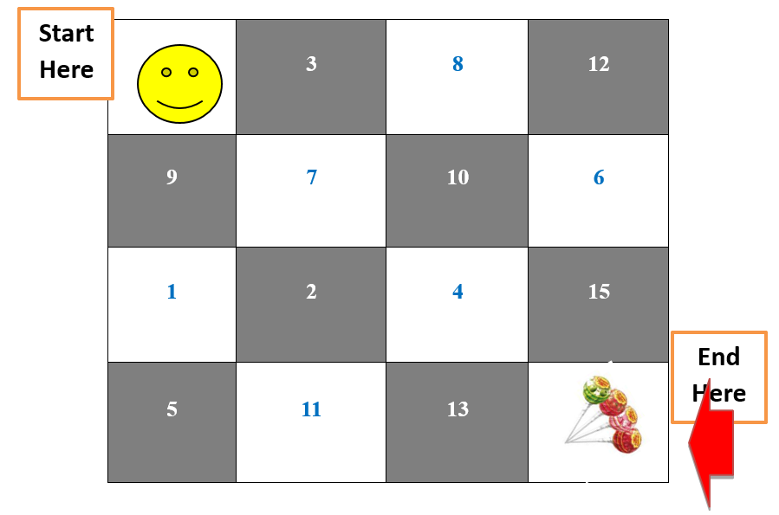
Task 3
Tell your friend how to move the smiley face to the last box where the lollipops are
NB the smiley face can only move horizontally or vertically

Slide 11
Task 4
In the grid, fill in the missing numbers using 1,2,3,4
No number should be repeated horizontally or vertically.
 | 3 |  | 1
2
 |  |  | 3
3

Slide 12
Solution
4 | 3 | 2 | 1
2 | 1 | 3 | 4
1 | 2 | 4 | 3
3 | 4 | 1 | 2

Slide 13
Discuss how activities 1, 2 and 3 can help develop problem-solving skills and logical thinking

Slide 14
Computational Thinking
What is your understanding about computational thinking?

Slide 15
Computational thinking
Computational thinking is a problem-solving approach that involves thinking in a way that can be effectively processed by computers
It is a set of skills and thought processes used to formulate problems and their solutions in a way that can be executed by a computer

Slide 16
Components of computational thinking
1. Decomposition:
Breaking down a complex problem into smaller, more manageable parts.
It's like taking a big puzzle and dividing it into smaller puzzles. For example, if our big problem is 'cleaning your room,' we can decompose it into smaller tasks like 'pick up toys,' 'make the bed,' and 'put clothes in the wardrobe'"

Slide 17
2. Pattern Recognition
Identifying similarities or common patterns among problems or data
It's like noticing that when you brush your teeth, you always follow the same pattern: toothpaste, brush, rinse
In computational thinking, we look for patterns to help us understand and solve problems more easily

Slide 18
Example
Look at this sequence of numbers:
2, 4, 6, 8, 10
The pattern here is that each number is 2 more than the previous one. So, the pattern is "add 2 each time."
Days of the Week:
Consider the days of the week:
Monday, Wednesday, Friday, Sunday, Tuesday
The pattern is that the days skip one in the sequence. So, the pattern is "skip one day."

Slide 19
3. Abstraction:
Simplifying complex systems by focusing on the essential details and ignoring non-essential ones.
It's like looking at a map and only seeing the important roads and landmarks, not every single tree or house.
When we abstract, we simplify things to make them easier to understand.

Slide 20
Examples
Drawing a Tree:
Imagine you want to draw a tree
Instead of drawing every single leaf and detail, you can simplify it by drawing a green blob for the leaves and a brown rectangle for the trunk
This way, you're abstracting the tree into basic shapes to make it easier to draw.
Serving yourself tea:
When you serve yourself tea, you don't need to think about all the details of each step and ingredients.
You abstract by focusing on the main steps: put a cup on the table and pour tea in it.
You don't need to think about the specific details of each ingredient in the tea, how the cup is made, or how long the tea took to cook.

Slide 21
Algorithmic Thinking:
Developing a step-by-step solution or set of instructions to solve a problem.
In computational thinking, we create algorithms to help computers and ourselves solve problems.
For example, an algorithm to clean your room could be '1. Pick up toys, 2. Make the bed, 3. Put clothes in the wardrobe.'"

Slide 22
Coding
What is coding?

Slide 23
Coding
Coding can be defined as the process of making and using sets of instructions to enable a computer to perform a ask {for example to play a game} or solve problems {for instance making a way out in a maze}.

Slide 24
Programming
Programming is giving instructions to a computer or a device to perform specific tasks or solve problems.
It involves writing a series of step-by-step instructions called codes that tell the computer what to do.
Just like we use words to communicate with other people we use codes to communicate with computers.

Slide 25
Conclusion
In this session, you have learnt how to:
Games
Computational thinking
Decomposition
Pattern recognition
Abstraction
Algorithm design
Coding
programming

