Slide 1
UNIT 2: Learner Centred Pedagogies and ICT Management Tools.
Facilitator:

Slide 2
Introduction
The unit is organised into:
Introduction,
Rationale,
Learning outcomes,
Content,
Activities in learner centred pedagogies and the use of ICT management tools.
We will discuss STEM activities that promote learner-centred lessons.

Slide 3
Rationale
Kenya’s vision of producing globally competitive learners with competencies for the 21st Century.
MOE supports this vision by ensuring provision of quality education in line with the international commitments to providing inclusive, quality and appropriate education per SDG Goal 4 and Competency Based Curriculum (KICD, 2017).
Quality Assurance and Standards aims to ensure quality teaching in learning institutions (National Education Quality Assurance and Standards Framework 2019; MOE, Kenya).
QASO’s are pedagogical leaders, they ensure effective curriculum implementation.
The content for this unit is informed by the feedback from the QASOs training by CEMASTEA held in November 2022, and observations made during JS monitoring and support.

Slide 4
contd
The session offer an opportunity for the QASOs to deepen their understanding of learner centred pedagogies such as IBL for effective learning in STEM.
Empower QASOs with skills in ICT management tools to execute their mandate.

Slide 5
Learning Outcomes
By the end of the session, the participants should be able to:
Describe IBL for effective implementation of STEM activities.
Describe ICT integration for effective implementation of STEM activities.
Demonstrate ability to design activities that promote IBL and ICT integration for effective teacher support.
Demonstrate ability to use ICT tools for effective monitoring and support of classroom practices
Appreciate the role of IBL, ICT integration for effective learning

Slide 6
Section 1: Deeper understanding of IBL, ICT integration in Learning
Focus is on Inquiry Based Learning (IBL) and ICT Integration in a lesson.
SMASE INSET activities have encouraged teachers to use learner-centred and innovative teaching strategies.
These strategies include the IBL, PBL and PrBL and ICT integration
STEM teachers trained on 5E instructional model and the TPACK model for ICT lessons.
Classes that allow learner minds-on and hands-on interactions.
How? Through effective question skills, ‘practice and drill’ in mathematics, effective experimentation in science, skills in communication and collaboration through group discussions and learner presentations in class.

Slide 7
Why Learner Centres Pedagogies
Learner centred pedagogies :
Learner centred pedagogies are widely promoted internationally as examples of ‘best practices’ in learning
Learner centred pedagogies:
Consider the learners’ needs, capacities and interests
Give learner active control over the process of learning
Emphasizes on performance based learning where learners carry out tasks facilitated by the teacher

Slide 8
Meaning of learner centred pedagogy
Meaning of learner centred pedagogy
i) What do you understand by the term Learner centred pedagogy?
Give examples….
Reflection

Slide 9
You may have mentioned some of the following about Learner Centered pedagogies
LCP are instructional methods that promote active learning and support the development of competencies and values in learners.
Learners work collaboratively to acquire new learning.
Opportunities are availed to learners to create and share information with other learners.

Slide 10
Inquiry Based Learning (IBL)
(Think, Pair & Share)
Activity 1 (5 minutes)
What do you understand by the term inquiry?
What is Inquiry Based Learning?

Slide 11
You may have mentioned the following
Inquiry-Based Learning is a learner centred method of teaching and learning that places learners’ questions, ideas and observations at the centre of the learning experience.
Through IBL, learners are engaged in authentic investigations in which they identify problems, ask questions, propose solutions, make predictions, design procedures, collect and organise data and draw conclusions.
components of Inquiry-Based Learning include data collection, data analysis and drawing of conclusions.

Slide 12
IBL – Learning Process
Teacher and students take time to look back at the concepts encountered, synthesis & engage further planning
Students formulate own questions. Teacher give introduction talk
ASK
REFLECT
INVESTIGATE
Student Collect information, exploit resources, experiment, interview
Students share their ideas with each other. They compare notes discuss conclusions and share experiences
DISCUSS
CREATE
Students merge information and make links to create new knowledge
Figure 1: Process of Inquiry Based Learning
Source: http://idtoolbox.eseryel.com/inquiry-learning.html

Slide 13
Levels of Inquiry Based Learning
Confirmatory inquiry - Teacher has absolute control over every phase of the process, and makes all the decisions. Students are provided with the key inquiry question to be answered, the procedure as well as the results of an investigation. The teacher also provides all the necessary information, materials and apparatus and asks the students to carry out the procedure.
Structured inquiry- Students are provided with key inquiry questions, methods and materials and are challenged to discover relationships between given variables.
Guided inquiry- Students are provided with a key inquiry question. However, the method for research is up to the students to develop.
Open inquiry- The phenomena are proposed to students, but students must develop their own key inquiry question and method for research to discover relationships among variables.

Slide 14
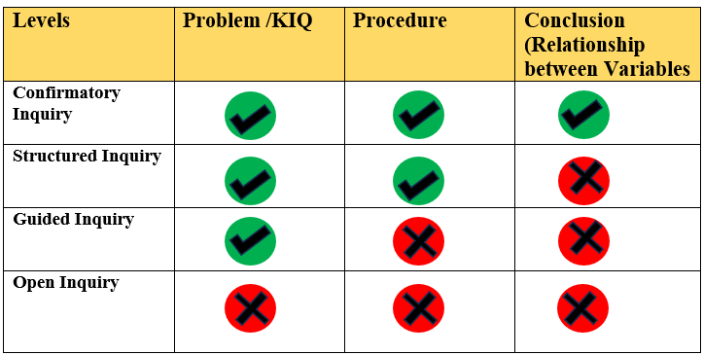

Slide 15
Support the teacher to move from confirmatory to guided.
The open Inquiry is not recommended for classroom experiences.

Slide 16
Activity to demonstrate Inquiry Based Learning
You are provided with a piece of plasticine, water and container.
1. What would happen if the piece of plasticine is placed in water?

Slide 17
Cont…….
2. How would you make the piece of plasticine float over the water?

Slide 18
Explanation
The solid plasticine sinks in water because its density is greater than that of water.
Shaping the plasticine like a boat increases its volume without increasing its mass, which decreases its overall density (mass/volume). If the density of the object is less than the density of water, it will float.

Slide 19
Cont……….
Similarly, a piece of iron is solid, and has a density greater than that of water that is why it sinks in water.
A ship has a thin layer of iron on the outside with an air pocket in the middle, decreasing the overall density of the ship enough to be less than that of water, allowing it to float.

Slide 20
IBL in Learning Agriculture & Nutrition

Slide 21
IBL Activity- Observation
What is happening in the two pictures below?
What do you think could be the issue here?
How can the issue be addressed?

Slide 22
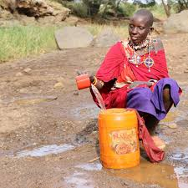
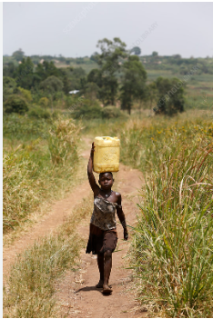
Picture 1
Picture 2

Slide 23
Key Inquiry Question
How is harvested water stored for domestic use?

Slide 24
Possible responses
Drilling boreholes
Piped water
Rain water harvesting. How?
Use of gutters
Constructing dams/ pans/ ponds
Wells
Storage of harvested rain water. How?
Water pans /ponds
Dams
Water tanks of varied sizes
Jerry cans, bottles, sufurias, pots

Slide 25
Activity 3:
Participants to improve the lesson prepared in unit 1, to reflect IBL activities in line with the learning outcomes

Slide 26
ICT Integration in STEM
ICT integration involves use of technology to enhance achievement of learning outcomes.
ICT can be used in all aspects of the lesson to introduce, reinforce or enrich concepts for ease of understanding.
Use of ICT in teaching and learning should be purposeful and therefore it should add value to the learning process. One of the ICT integration models that is easy to use and helpful to teachers is the Technological, Pedagogical and Content Knowledge (TPACK) model.
Reflection
i. What do you understand by TPACK model?

Slide 27
The TPACK model
The TPACK model is technology integration to teaching and learning framework
1. Content knowledge circle – teacher’s knowledge in the subject content of specialisation, subject mastery in the field of specialisation. For example, considering a teacher teaching physics it could refer to physics content mastery.
2. Pedagogical knowledge circle – the ability of the teacher to apply the right strategies to deliver the subject matter to learners effectively.
3. Technological knowledge circle –the ability by the teacher to come up with the best and most suitable technological tools to enhance the learning process.

Slide 28
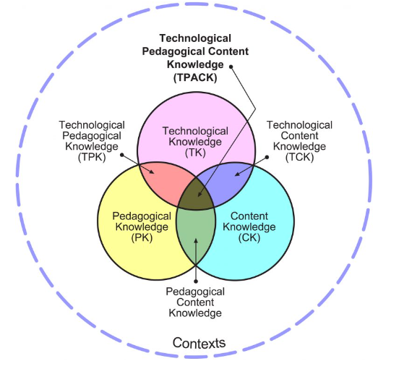
TPACK Model
Reflection
Have you observed a TPACK model during lesson observations in the field?
What are the interventions you can implement to improve an ICT integrated lesson to support a teacher in implementing the curriculum?

Slide 29
A Guide to Planning TPACK Model Lesson
As a pedagogical leader, you can guide the teachers in answering the following questions for an effective ICT integrated lesson.
1. What am I going to teach? – the answer to this question leads the teacher to content knowledge (CK). What content or concept are you going to teach? This prompts one to use the syllabus and follow the right content for the level being taught.
2. How am I going to teach it? The answer to this question leads one to pedagogical knowledge (PK). What strategies will one use to teach that concept, will you require group discussion? What kind of learning activities are you going to use for that concept?
3. What technologies am I going to use? The answer here leads to technological knowledge (TK). This will help the teacher choose the right technological tools for use to teach the concept in question.

Slide 30
Share your experiences….
What have you been able to observe?
How can you help a teacher to be able to identify the ICT in use in the classroom
During Lesson observe a lesson, how would you promote IBL based lesson?

Slide 31
ICT related Resources that you can guide teachers to use in a class
Online resources
https://phet.colorado.edu/en/simulations/filter?subjects=math&type=html,prototype https://phet.colorado.edu/sims/html/energy-forms-and-changes/latest/energy-forms-and-changes_en.html
https:/Geogebra.org (this resource can be used offline if the software is downloaded and installed ina computer) Link to teach nets in a solid: https://www.geogebra.org/m/pCv2EvwD
https://Kec.ac.ke
https://portal.cemastea.ac.ke (registration to the portal for e-certificate)
Offline resources
Resources created or obtained using smartphones such as pictures, videos and animations. This may include resources shared through social networking sites such as , WhatsApp, TikTok, Instagram, Facebook among others.
Applications downloads to the phone (play store for android and iTunes for Apple products)

Slide 32
Section 2: Use of ICT Tools for Management
Introduction
QASO play an important role in effective implementation of the curriculum, data collection, data management, report writing among others. ICT as a tool for management can help the QASO’s to effectively undertake this task seamlessly.
In this section, we will discuss virtual applications that can be used to manage meetings, automated online data collection forms and automated online report writing.

Slide 33
Virtual online platforms
Virtual meeting platforms are video applications and software that bring people together over the internet for real-time interactions and discussions. The transmission of information is in the form of audio, video and text. Examples of these platforms include Microsoft Teams, Skype, and Zoom.
For this session, we will focus on Google meet, google forms and google docs.

Slide 34
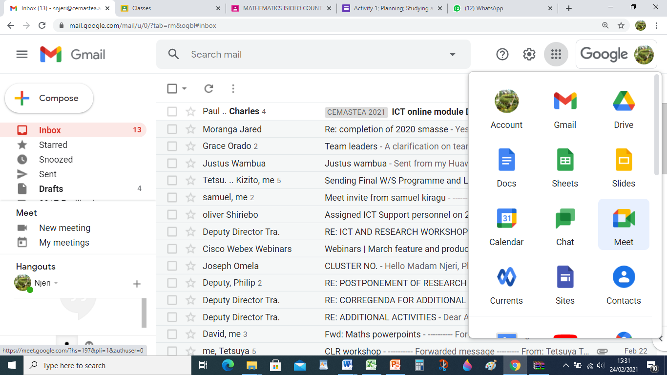
Google Meet
Google Meet is a virtual platform by Google. It offers free video communication services while online.
Accessing Google Meet
Click on the nine dots on your Gmail account and scroll through for the meet icon.

Slide 35
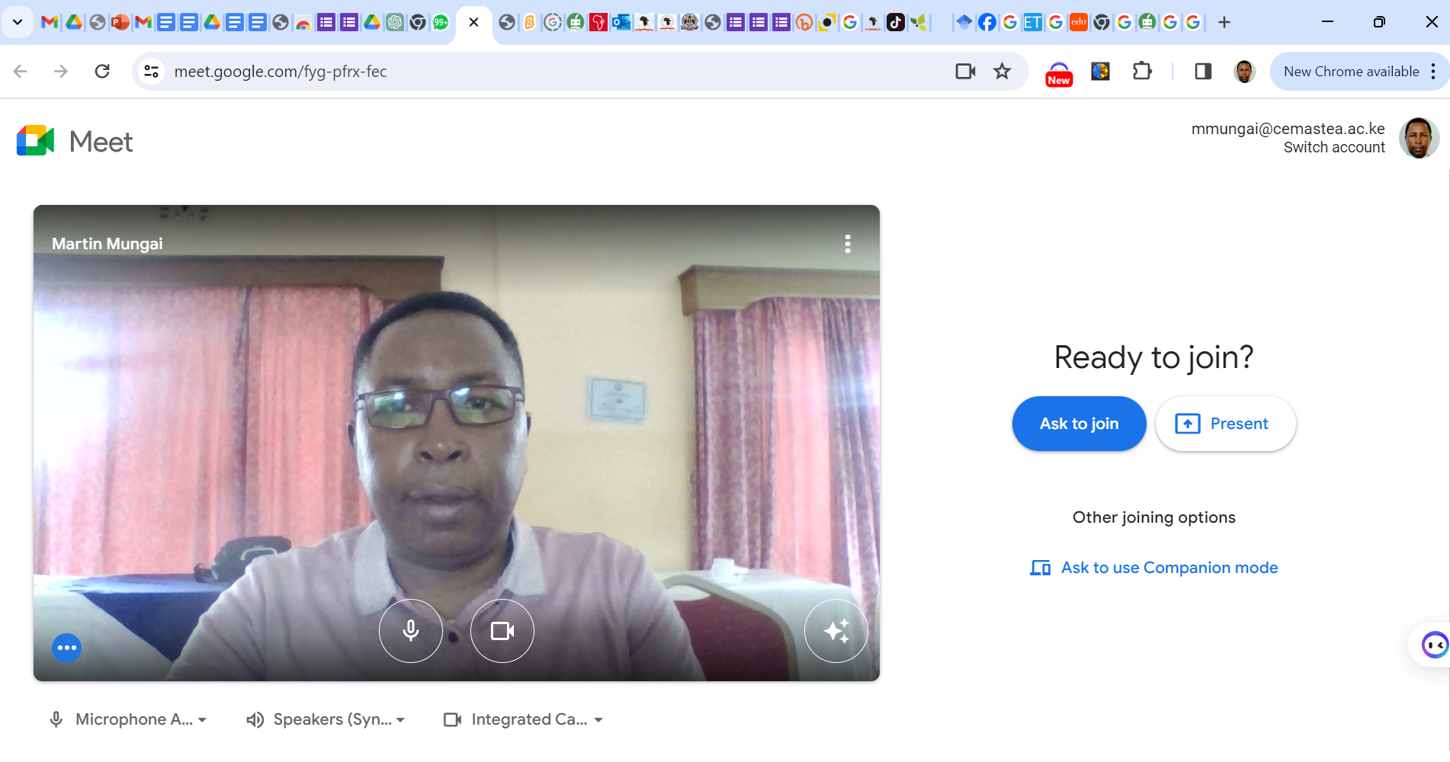
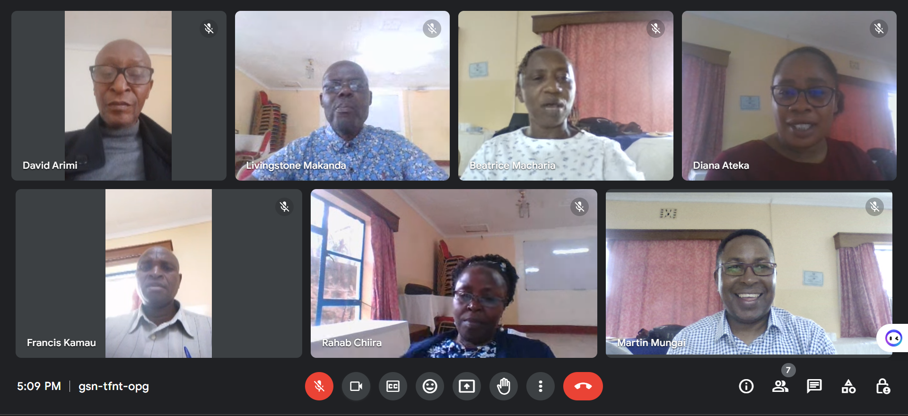
2
3
7
5
9
1
6
8
4

Slide 36
Turn ON/OFF Mic
Turn ON/OFF Video
Send a reaction (smiley, clap, thumbs up…)
Share a presentation
Raise Hand
Drop/End Call
Meeting information
View Participants in the meeting
View Chat

Slide 37
Activity 1
Activity1 (Asynchronous)
Proceed in a step by step
Exploring on every tab until you host a live meeting. Write brief explanation for each tab.
Start an Instant meeting
Click on the “Start an Instant meeting” and explore
Schedule in Google CalendarClick on the “Schedule in Google Calendar” and explore

Slide 38
Activity 2
Activity 2
Create and shedule a meeting using Google Meet
Invite members of your group to your meeting
Present/ teach the lesson you prepared in unit 3
Evidence of a virtual meeting - screen shots

Slide 39
Netiquettes
Be punctual: Join the virtual meeting on time. Logging in late can disrupt the flow of the meeting and inconvenience others.
Test your technology: Ensure your audio, video, and internet connection are working properly before the meeting starts. Familiarize yourself with the meeting platform to avoid technical issues during the session.
Dress appropriately: Even though you're attending remotely, dress as you would for an in-person meeting, unless otherwise specified by your organization.
Choose a suitable environment: Select a quiet, well-lit space for the meeting. Minimize background noise and distractions to maintain focus. Ensure your background is professional and uncluttered. Consider using virtual backgrounds if necessary.
Introduce yourself: If the meeting involves people who may not know each other, introduce yourself briefly when speaking for the first time.

Slide 40
Contd’…
Use professional language: Maintain a professional tone and avoid using slang, jargon, or offensive language.
Be attentive and engaged: Demonstrate active listening by focusing on the speaker and avoiding multitasking. Use non-verbal cues like nodding or smiling to show engagement.
Mute your microphone when not speaking: This helps minimize background noise and prevents disruptions. Remember to unmute when you need to speak.
Avoid interrupting others: Wait for an appropriate pause before speaking. Use the "raise hand" feature if available to indicate you have something to contribute.
Use chat appropriately: If there's a chat feature, use it to share relevant links or resources, ask questions, or provide feedback. Avoid side conversations that can distract from the main discussion.
Follow meeting guidelines by adhering to any specific meeting rules or protocols set by the organizer. Thank the host and participants: Express gratitude at the end of the meeting for their time and contributions

Slide 41
Google Forms
A tool that QASOs can use to collect data online.
The user can easily create and share online forms and have the data analysed in real-time (as they come).
How to create Google Forms from your Computer
Step 1: Set up a new form or quiz
Go to forms.google.com.
Click Blank

Slide 42
.
A new form will open.
Step 2: Edit and format a form or quiz
You can add, edit, or format text, images, or videos in a form.
Edit your form
Create a quiz with Google Forms
Choose where to save form responses
Step 3: Send your form for people to fill out
When you are ready, you can send your form to others and collect their responses.
How to create Google Forms from your Android Phone
Step 1: Set up a new form or quiz
On your Android phone or tablet, open a mobile web browser, like Chrome.
Go to forms.google.com.
A new form will automatically open.
Step 2: Edit and format a form or quiz
You can add, edit, or format text, images, or videos in a form.
Edit your form
Create a quiz with Google Forms
Choose where to save form responses
Step 3: Send your form for people to fill out
When you are ready, you can send your form to others and collect their responses.

Slide 43
Google Docs
Google Docs is an online word processor that lets you create and format documents and work with other people.
Step 1: Create a document
To create a new document:
On your computer, open the Docs home screen at docs.google.com.
In the top left, under "Start a new document," click Blank
.
You can also create new documents from the URL docs.google.com/create.
Step 2: Edit and format
To edit a document:
On your computer, open a document in Google Docs.
To select a word, double-click it or use your cursor to select the text you want to change.
Start editing.
To undo or redo an action, at the top, click Undo
.
Step 3: Share & work with others
You can share files and folders with people and choose whether they can view, edit, or comment on them.

Slide 44
Activity 3
Activity 3
In your counties, write a joint report using the google doc, with members working collaboratively to have one common report

Slide 45
Polling Apps
Polling apps are software tools designed to facilitate the creation, distribution, and collection of responses for polls or surveys. These apps are widely used in various contexts, including market research, education, event planning, and decision-making processes. Here are a few examples of polling apps along with a brief overview of how they work:
Kahoot!: Kahoot! is a game-based learning platform that allows users to create and play quizzes, surveys, and polls. It's widely used in educational settings for engaging students in learning activities.
Mentimeter: Mentimeter is a real-time presentation and polling tool that allows presenters to engage with their audience by creating interactive presentations with polls, quizzes, word clouds, and more.
Poll Everywhere: Poll Everywhere is a polling platform that allows users to create live polls and surveys that can be embedded into presentations or websites. Participants can respond to polls using their smartphones or other devices.
Slido: Slido is an audience interaction platform that allows users to create live polls, Q&A sessions, quizzes, and surveys for events, meetings, and conferences. Participants can join
SurveyMonkey: SurveyMonkey is a popular online survey platform that offers a wide range of survey and polling features. Users can create surveys, quizzes, and polls for various purposes, including market research, customer feedback, and employee engagement.

Slide 46
Conclusion
The session covered Learner centred pedagogies and the use of ICT management tools.
You discussed and explored the meaning of learner centred pedagogy, IBL and ICT integration in teaching and learning.
You used ICT management tools, such as google forms, google meet, google docs and mentimeter applications.
It is expected that the knowledge and skills acquired during the discussions will enable you to empower the teachers in your schools motivate the students.

Slide 47
The End

