Slide 1
UNIT 1: LEARNER CENTRED PEDAGOGIES
SECTION 1
Facilitators:

Slide 2
Introduction
Unit one of this module focuses on learner centred pedagogies
Some of the areas included in the unit are:
Rationale
Learning outcomes
Learner centred pedagogies with a focus on Inquiry Based Learning (IBL)
What is IBL?
Example of an IBL activity
Subject based activities incorporating IBL

Slide 3
Session Plan
Aspect | Time
Preliminaries : Introduction, Rationale , session outcomes & Inclusion of learners with special needs | 10 minutes
Learner Centred Approaches | 15 minutes
Inquiry Based Learning (IBL) | 25 minutes
An example of an IBL activity | 35 minutes
Example of IBL activity in Agriculture & Nutrition Pre-technical studies | 40 minutes 40 minutes

Slide 4
Rationale
Learner centred pedagogies :
Learner centred pedagogies are widely promoted internationally as examples of ‘best practices’ in learning
Learner centred pedagogies:
Consider the learners’ needs, capacities and interests
Give learner active control over the process of learning
Emphasizes on performance based learning where learners carry out tasks facilitated by the teacher

Slide 5
Session Outcomes
By the end of the unit, the participant should be able to:
Describe Inquiry-Based Learning (IBL)
Develop IBL activities in Pre-technical studies and Agriculture and Nutrition
Appreciate the use of IBL for effective learning

Slide 6
Reflection 1
Share how you facilitate learning in your subject areas

Slide 7
Reflection 2
What do you understand by learner centred pedagogies? Give examples

Slide 8
Learner Centered pedagogies ( LCP)
LCP are instructional methods that promote active learning and support the development of competencies and values in learners.
Learners work collaboratively to acquire new learning.
Opportunities are availed to learners to create and share information with other learners.

Slide 9
Learner centered pedagogies ( LCPs)
Learner centred pedagogies include:
Inquiry Based Learning,
Problem Based Learning and
Project Based Learning

Slide 10
Inquiry Based Learning (IBL)
(Think, Pair & Share)
Activity 1 (5 minutes)
What do you understand by the term inquiry?
What is Inquiry Based Learning?

Slide 11
Inquiry Based Learning (IBL)
Inquiry is the process of seeking answers to questions
Inquiry-Based Learning is a way of learning by discovery
Learners carry out activities to answer questions or discover
IBL is usually guided by key inquiry question(s)
The curriculum designs provide suggested key inquiry questions for the sub-strands

Slide 12
The process of Inquiry-Based Learning

Slide 13
Strategies
How can you implement Inquiry Based learning in the classroom?
(5 minutes)
Reflection 3

Slide 14
IBL in the classroom
You may have suggested some of the following:
Clearly defined task/ question
Provide key inquiry question
Allow for exploration
Encourage discussion (Think-Pair and share and group work/ discussion
Predict Observe Explain ( POE)
The teacher assesses whether the learners have accomplished the task or answered the question as per the expectations. The learners can also be given an opportunity to assess themselves

Slide 15
Activity to demonstrate Inquiry Based Learning
You are provided with a piece of plasticine, water and container.
1. What would happen if the piece of plasticine is placed in water?

Slide 16
Cont…….
2. How would you make the piece of plasticine float over the water?

Slide 17
Explanation
The solid plasticine sinks in water because its density is greater than that of water in which it is floating. When it is made hollow (shaped like a boat) the hollow part contains air.
The average density of the air it contains and the plasticine itself becomes less than that of water and therefore it floats.

Slide 18
Explanation…..
Similarly, a piece of iron is solid, and has a density greater than that of water that is why it sinks in water.
A ship has a thin layer of iron on the outside with an air pocket in the middle, decreasing the overall density of the ship enough to be less than that of water, allowing it to float.

Slide 19
IBL in Learning Agriculture & Nutrition

Slide 20
IBL Activity- Observation
What is happening in the two pictures below?
What do you think could be the issue here?
How can the issue be addressed?

Slide 21
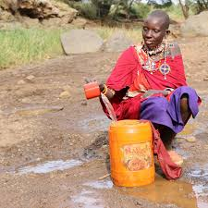
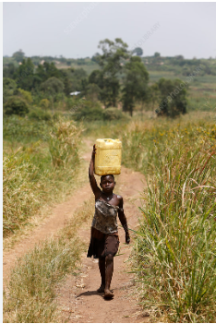
Picture 1
Picture 2

Slide 22
Key Inquiry Question
How is harvested water stored for domestic use?

Slide 23
Possible responses
Drilling boreholes
Piped water
Rain water harvesting. How?
Use of gutters
Constructing dams/ pans/ ponds
Wells
Storage of harvested rain water. How?
Water pans /ponds
Dams
Water tanks of varied sizes
Jerry cans, bottles, sufurias, pots

Slide 24
IBL activities in Pre-technical Studies

Slide 25
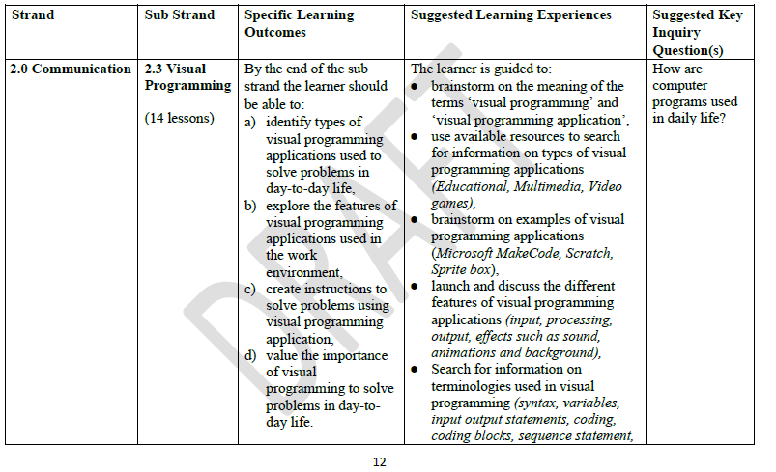
Grade 8 PST design

Slide 26
IBL ACTIVITY
KIQ: How can you make a sprite to communicate?
Activity
Explore how you can:
i) control the speed of the sprite .
ii) add speech to the sprite for communication

Slide 27
Introduction
Visual programming is a substrand in the strand of communication in Pre-technical Studies in Grade 8.
It aims at introducing learners to programming.

Slide 28
What is programming?
A program is a set of instructions that tells a computer or other electronic device what to do.
These instructions or commands are written in an artificial (i.e. non-speaking) language.
The script used is often referred to as code or computer code.
Computer programing or coding is the process of writing code.

Slide 29
Reflection 1
What are some of the programming languages that you are familiar with or have heard of ?

Slide 30
Possible responses
Your suggestions may have included:
Blockly, Swift Playgrounds, Kodable, Python, Tynker, Minecraft, Hopscotch, Scratch, and Microsoft Makecode-Arcade.

Slide 31
What is visual programming?
Visual programming is a method of web and software development that uses graphics and images, rather than purely text, to build out computing logic.
Visual programming languages (VPLs) are coding languages that use graphical elements, such as blocks, icons, and symbols, to represent programming concepts and logic.

Slide 32
Examples of visual programming applications
Examples of visual programming applications include Scratch, Microsoft Makecode-Arcade and Sprite Box

Slide 33
Why is visual programming important?
Visual programming promotes
Engagement:
Visual programming applications like Scratch typically feature colorful sprites, interactive elements, and immediate feedback, which captivates the learners interest and keep them engaged in the learning process.

Slide 34
Why is visual programming important?......
This engagement fosters a positive attitude towards learning and encourages continued exploration of programming concepts.
Creativity and Problem-Solving:
Learners are empowered to express their creativity by designing animations, games, stories, and other multimedia projects.

Slide 35
Why is visual programming important?......
It encourages experimentation and problem-solving as learners iteratively build and refine their creations, fostering critical thinking skills and a growth mindset

Slide 36
Reflection 1
What are the key features of the Scratch 3.0 interface?

Slide 37
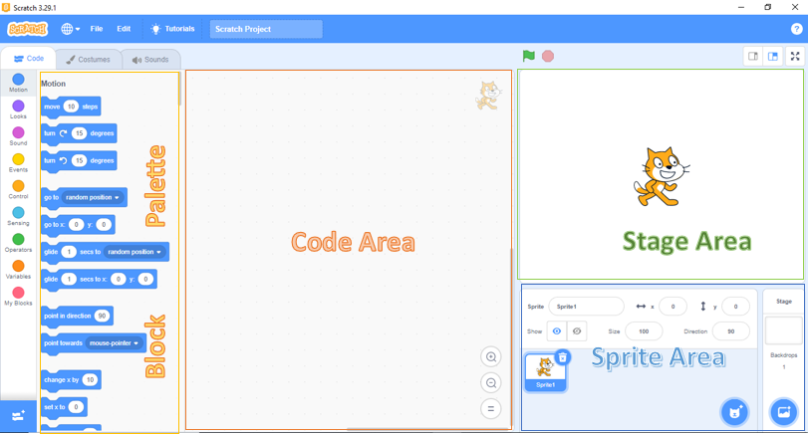
Features of Scratch 3.0 interface

Slide 38
Reflection 2
How do you create an animation in scratch 3.0?

Slide 39
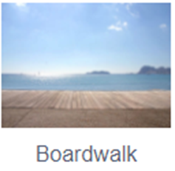
An example of a simple animation in Scratch 3.0
Open Scratch 3.0 application
Note the default sprite Cat in the stage area.
Choose the Boardwalk backdrop

Slide 40
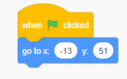
Animation…
d) Go to the Block pane, choose the event category of blocks. Drag and drop it the code area
e) Click on the motion category of blocks and select the go to and stack it below

Slide 41
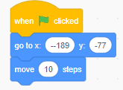
Animation…
f) To position the sprite at the bottom left corner, specify the (x, y) as (-189,-77) in the go to block.
g) Click on the motion block category and select move 10 steps and stack it below the go to block

Slide 42
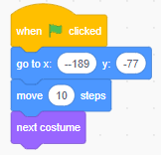
Animation…
h) Click on the looks block category, select the next costume and stack it under the move

Slide 43
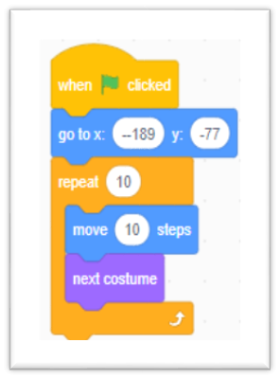
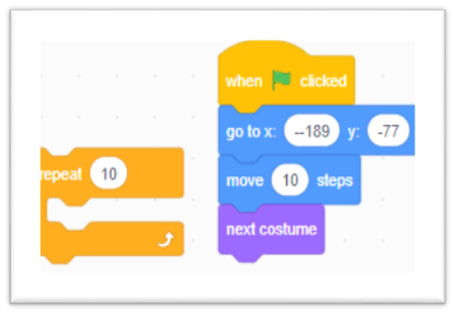
Animation…
j) Click on the control block to select the repeat 10 times block and nest the move and next costume
What happens when you click the green flag ?

Slide 44
Conclusion
In the Part One of Unit 1, you have been introduced to:
Learner centred pedagogies
Inquiry Based Learning (IBL)
Visual programming
It is important that you continue:
- Implementing IBL in the classroom
-Exploring the Scratch 3.0

Slide 45
THE END

