Slide 1
Learning resources
Facilitator

Slide 2
Session plan
 | Sections | Time
1 | Rationale, session outcomes | 5 minutes
2 | i) Definition of learning resource ii) Reasons for using learning resources iii) Factors to consider in choosing or developing learning resources | 25 minutes
3 | Examples of resources in Pre-technical studies | 40 minutes
4 | Examples of resources in Agriculture and Nutrition | 30 minutes
5 | Improvisation and examples | 20 minutes
6 | Group discussion on | 1 hour
7 | Group reporting and harmonization | 1 hour

Slide 3
Rationale
Resources are important in the learning process since when used well, they help in demystifying abstract concepts.
The learning resources can either be convectional or improvised.
The purpose of this session is to discuss ways of sourcing for resources in teaching Pre-Technical , Agriculture and Nutrition learning areas.

Slide 4
Session outcomes
By the end of the session, you should be able to:
Describe a learning resource
Discuss factors to consider in choosing or developing learning resources
Develop improvised learning resource for learning a concept in Pre-technical studies and Agriculture and Nutrition
Appreciate the importance of learning resources in enhancing achievement of learning outcomes

Slide 5
Use Think-Pair- Share strategy
Activity 1 (5minutes)
What is a learning resource?

Slide 6
Definition of learning resource
A learning resource is a material that a teacher uses to facilitate learning during a lesson.

Slide 7
Activity 2: Use Meet your
match strategy ( participants write their views in a coloured sticky note. They join those having the same colour of sticky note and share. Then groups share to plenary) Activity 2 (5minutes) Why use learning resources?

Slide 8
Reasons for using learning Resources
Learning resources :
Make learning more interesting, realistic and practical
enhance interactions among learners and their teachers during the learning process.
Enables better learning through play, manipulating concrete objects, dramatizing, role playing and observing their environment.

Slide 9
Use One- Minute Paper
( each participant to write down their response and give the neighbour to read to the plenary)
Activity 3 ( 5 minutes)
What factors do you consider when developing learning resources?

Slide 10
Factors to consider in choosing or developing learning resources
Level of learners (Age appropriateness, developmental level)
Cost effectiveness (locally available resources)
Durability
Safety
Availability
Attractiveness

Slide 11
Factors to consider in choosing or developing learning resources cont….
Interesting ( the material should arouse the interest of the learners)
Challenging (The resource should be able to challenge the learner)
Appropriateness to manipulation
Versatility
Relevance

Slide 12
Examples of learning resources in Pre-Technical Studies

Slide 13
Non Digital (Realia) Resources learning resources in Pre-Technical Studies
Strand: Materials for production
Sub strand: Composite Materials
Expected Outcome: By the end of the lesson, the learner should be able to correctly identify composite materials within their environment.

Slide 14
Group Discussion
(- display the images and allow
participants to explain while justifying the choices)
Activity 5 ( 5 minutes)
Which among the following are composite materials? Explain

Slide 15
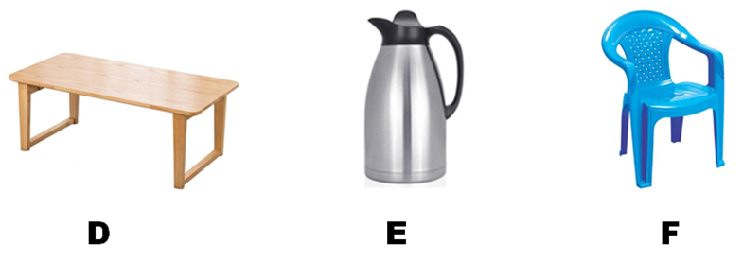

Slide 16
Composite materials
A,C and E are composite materials since they are made up of more than one material
A: Glass Reinforced table made of glass and wood
C: Cooking spoon made of metal and wood
E:Thermoflask: made of metal, silvered glass and plastic

Slide 17
Definition of composite materials
A composite material is a combination of two or more materials in a controlled way to get the desired material with better properties.

Slide 18
Reasons for using Composite materials
Use Group concept mapping (participants watch the video and answer questions in their groups)
Activity 6 ( 10 minutes)
Watch the following video and explain the reason for using the composite materials

Slide 19
Video

Slide 20
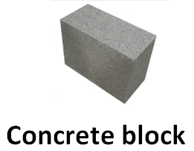
Reasons for using the composite materials
The reasons for using the composite materials in making the reinforced concrete block is to provide high strength and durability

Slide 21
Other reasons for using Composite materials
Lightness and low weight (e.g in aerospace and automotive industries)
Corrosion resistance ( building industry)
Fire resistance ( building, aerospace, automotive etc)
Improved electrical properties ( electrical and electronics industry)

Slide 22
Classification of composite materials
Composite materials are classified in two broad categories, namely:
Matrices: Formed by mixing two or more materials e.g concrete block
Reinforced composites: Formed by reinforcing a foreign material on a parent material e.g. reinforced glass window or door

Slide 23
Use strategy : Gallery Walk
( groups will write their responses on flip chart and display in their area/corner. Participants will take a gallery walk around the room to get presentations by groups and share more examples from other participants)
Activity 7 ( 15 minutes)
In your groups take a walk within the environment and identify composite and non composite materials

Slide 24
You may have identified some of the following examples of composite materials and non composite met

Slide 25
More examples of composite materials
Pipe connector: steel coated with plastic
Plastic coated paper foil

Slide 26
More examples of composite materials
Reinforced glass door: made of hardwood and glass

Slide 27
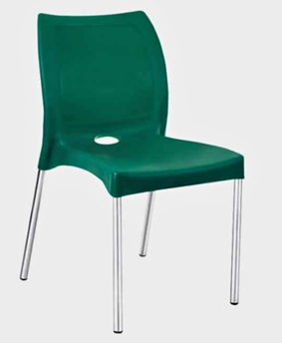
More examples of composite materials
Smartphone: made up of metallic, plastic and glass components
Reinforced plastic chair made of plastic and metal

Slide 28
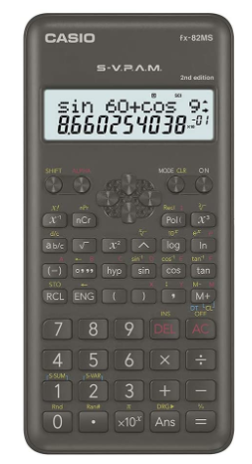
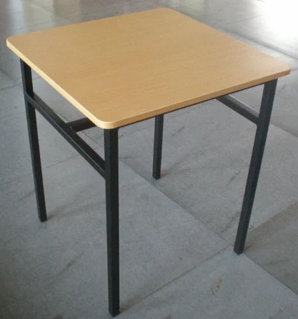
More examples of composite materials
Calculator : made up of metallic, plastic and glass components
Reinforced table made of wood and metal

Slide 29
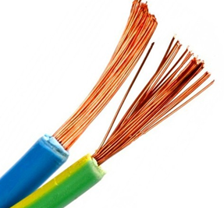
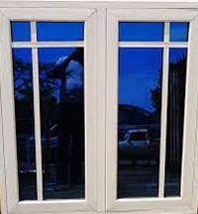
More examples of composite materials
Electrical cable : made of copper wire insulated with rubber
Reinforced glass window : made of metal and glass

Slide 30
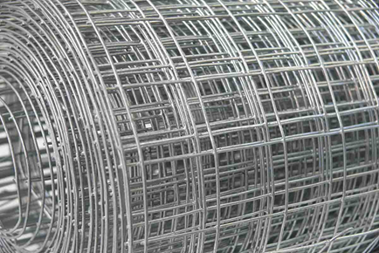
More Examples of Non Composite items
Wire mesh made of metal
Drinking glass

Slide 31
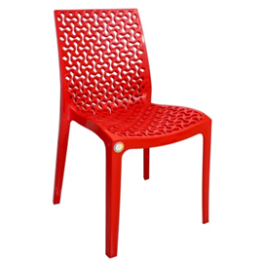
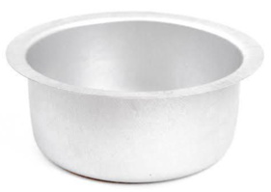
More Examples of Non Composite items
Cooking pot/Sufuria made of metal
Plastic chair

Slide 32
Importance of digital resources
Digital resources
help learners to improve retention of the concept being taught.
help learners in conceptualization of concepts
e.g conceptualization of the concrete block as a composite material was enhanced by observing the process through the video clip
Note: its important to let the learners make the concrete block practically

Slide 33
Agriculture and Nutrition

Slide 34
Examples of Resources Agriculture and Nutrition
Learning area : Agriculture and Nutrition
Strand: Conservation of Resources
Sub-strand: Soil conservation measures
Specific learning Outcomes:
Describe methods of soil conservation in Agricultural environment

Slide 35
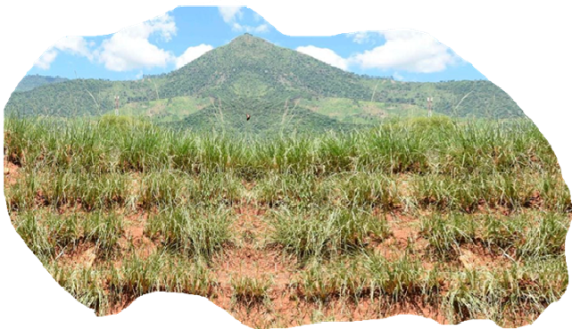
1. Non Digital Resources
a) Newspaper Articles
Picture showing a section where soil erosion had occurred and then reclaimed by planting vetiver grass.
Source: Excerpts from a story by Fred Kibor, Nation Media Group. Thursday, August 31, 2023

Slide 36
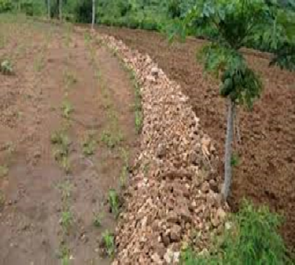
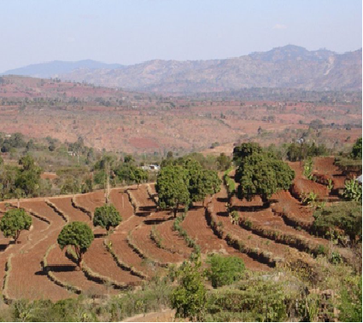

Slide 37
c) Realia:
A sight visit to an area where soil conservation is practiced can be used as a resource for teaching. Discuss with students the type of soil conservation in the visited area.

Slide 38
2. Digital learning resource
The following video clips links showing different types of soil conservation measures

Slide 39
IMPROVISATION
Use One- Minute Paper
( each participant to write down meaning of improvisation and give the neighbour to read to the plenary)
Activity 4 (5 minutes)
What is improvisation?

Slide 40
Definition of improvisation
Improvisation is the use of substitute materials or equipment that can be found in the immediate surroundings
The improvised material is created by the teacher or the learners

Slide 41
Reasons for improvisation
Improvisation is done :
Where there is lack of conventional teaching and learning materials
To scale down the size of the material proportionally, and reducing the cost
To make familiar teaching and learning resources for easy assimilation of concepts

Slide 42
Importance of improvising learning Resources
To provide a bridge between abstract and concrete learning
To widen the scope of learning
To develop process skills in learners
To provide materials in sufficient quantities thereby enabling learners to work independently.

Slide 43
Importance of improvising learning Resources
Engage learners actively
Enable the use of materials that are easier to manipulate
Enhance imagination and creativity
Reduce cost.

Slide 44
Example of improvised resources in Pre-Technical Studies
Learners may be involved in a project to make composite and non composite materials for example

Slide 45
Composite materials

Slide 46
Composite materials

Slide 47
Non Composite materials
Wooden spatulas

Slide 48
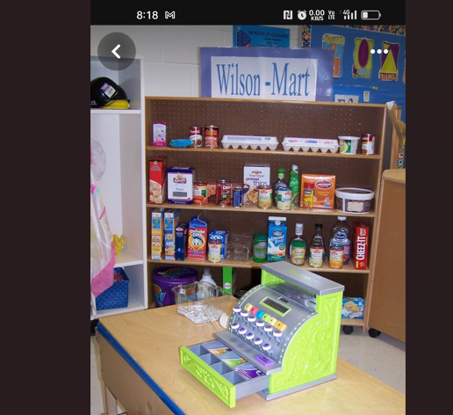
2nd Example :Shop corner
What concepts can be learned through the use of the shop corner?

Slide 49
Example of Improvisation in Agriculture and Nutrition
A model of soil conservation can be made in the school to demonstrate different types of soil conservation.
Use the model to teach the concept of soil conservation.

Slide 50
Group activity Use Crowd Sourcing ( participants work in a participatory group to develop learning resources)
Develop/source suitable learning resources based a strand in Grade 7 or 8 in
Pre-technical Studies
or
2) Agriculture and Nutrition

Slide 51
Conclusion
In this section, you have discussed learning
resources for enhancing achievement of learning outcomes.
We discussed the following in details:
Definition of learning resource
Reasons for using learning resources
Factors to consider in choosing or developing a learning resource
We also looked at example of resources in Pre-technical Studies and Agriculture and Nutrition as well as improvisation
It is hoped that you will enhance use of resources in the learning process

