Slide 1
Training on Coding for Middle School Teachers
Facilitator: CEMASTEA

Slide 2
Session One
Introduction to Coding

Slide 3
Session Objectives
By the end of the session, participants should be able to;
Identify various ways they can use to introduce coding to learners.
Appreciate the ability of coding in developing core competencies in the learners

Slide 4
Session Plan
Rationale, Objectives, Introduction 10mins
Reflection 1&2 10mins
Task 1 2 & 3 20mins
Exposition 1(coding & programming) 15mins
Exposition 2 (patterns and games) 15mins
conclusion and wrap up 5mins

Slide 5
Introduction
Coding has become an essential skill for children.
Learning process becomes engaging and enjoyable through activities that are exciting and combines game puzzles.
Learning coding is not an exception

Slide 6
Rationale
Study done by CEMASTEA, 2022 revealed that children enjoy playing games both digital and non-digital.
All digital games have been created using coding
This module is intended to provide you with the learning experience on how to develop coding skills in learners.

Slide 7
Reflection 1
Share on your favorite childhood games and briefly discuss why you enjoyed them.
Verbalize responses.

Slide 8
All these games and the reasons you enjoyed them, are all connected to creativity, logical thinking, problem solving and playfulness.

Slide 9
Reflection 2
Share the strategies you used to make others learn the game (s)

Slide 10
Strategies
Providing clear simple instructions
Incorporating demonstrations (Hands on activities)
Encouraging creativity and self expression
Offering scaffolding and guidance
All these are essential elements for coding

Slide 11
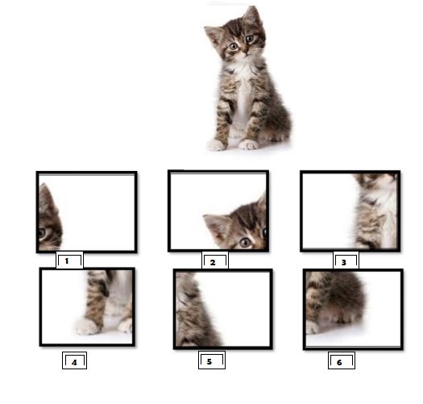
Task 1
Examine this task given to Grade Four learners
Discuss how this activity can develop logical thinking creativity and problem solving
Cut the out the pieces and build up the cat

Slide 12
Task 2
Use the link provided to build the truck within the shortest time possible
https://www.jspuzzles.com/en/transportation/vehicle/truck/pickup-truck/2459888

Slide 13
How does this activity promote logical thinking, problem solving and creativity?

Slide 14
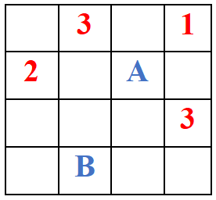
Task 3
In the grid fill in the missing numbers using 1,2,3,4
No number should be repeated horizontally or vertically

Slide 15
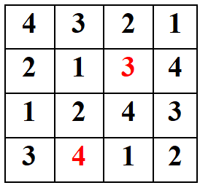
Correct Response

Slide 16
How does this activity promote logical thinking, problem solving and creativity?

Slide 17
Playful Approach to Coding
Curiosity and exploration are actualized by young children through games
Creativity, logical thinking, problem solving and playfulness are essential elements in coding
A playful approach to coding taps into their innate sense of play and makes learning experience enjoyable

Slide 18
Coding
What does coding mean to you?

Slide 19
Possible Responses
It is the process of developing and implementing various sets of instructions to enable a computer to perform a certain task, solve problems, and provide human inter-activity

Slide 20
Programing
What does programming mean to you?

Slide 21
Possible Responses
Programming, is giving instructions to a computer or a device to perform specific tasks or solve problems.
It involves writing a series of step by step instructions called codes
Just like we use words to communicate with other people we use codes to communicate with digital devices

Slide 22
Patterns and Games
What do you observe in the picture below?
A
B
C

Slide 23
Possible Responses
Spider Web
Banana leaf
Weaver bird nest
These patterns are unique to the objects irrespective of the locations they are found.
This is an example of a natural code.

Slide 24
Activity
Click the link https://scratch.mit.edu/projects/394885714/fullscreen/ and observe the animation.
Describe your observation

Slide 25
Cartoon
Click this link to access https://scratch.mit.edu/projects/860872082

Slide 26
Possible Responses
Patterns of different types being formed.
Synonymous to:
Patterns we come across in real life situations (Crocheting, weaving knitting)
Computer screen savers
These are all codes

Slide 27
Conclusion
We have explored play based learning-use of games, cartoons to enhance logical thinking, creativity and problem solving.
All these ingredients of coding

