Slide 1
HOW TO WRITE FOR A PRACTITIONER AUDIENCE: STYLE AND ETIQUETTE By Dr. Mercy Macharia

Slide 2
Expectations
What are your expectations for this session?

Slide 3
Introduction
This session highlights some of the aspects for considerations in writing articles for a practitioner audience.
It also includes etiquette and regulations for writing
Notes:
CoP focuses on sharing best practices and creating new knowledge to advance a domain of professional practice.
Limited classroom experiences among some teachers deployed to teach grade seven in JS thus requiring support
The JS guidelines recommend the formation of CoP at school level.
TSC TPD programs, require teachers to work in collaboration by establishing CoP in schools.

Slide 4
Reflection
In your view, what components should the framework/
structure of a Practitioner journal article include?

Slide 5
Considerations in Writing for a Practitioner Audience
Title
Abstract
Introduction
Body (Key ideas)
Conclusion
Style
Figures
Tables
Photographs
Citations
References
Etiquette in Writing
Plagiarism
Consent

Slide 6
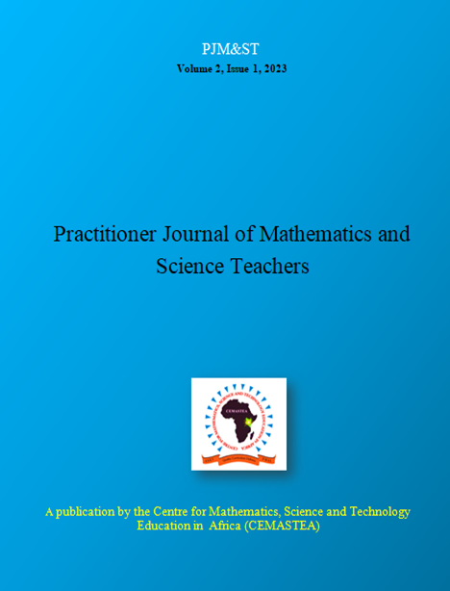
PJMST Articles Writing Template
Practitioner Journal of Mathematics and Science Teachers, (PJMST) Article Template
Different journal prescribe their own style of writing

Slide 7
The title of your article and the introduction should catch the eye and attention of the readers and drive them to yearn to learn more about your topic hence continue reading
Example “Cheerful incidents: An opportunity for learning through reflective practice”

Slide 8
Reflect on your experiences as a teacher and come up with a captivating title for an article that you would like to publish in a practitioner journal.
Reflection

Slide 9
ABSTRACT
Is summary of the entire the major aspects of the entire paper, usually in one paragraph of 250-300 words
Includes: 1) the purpose of the study and the research problem(s) investigated; 2) the methodology; 3) major findings and recommendations
Keywords (Maximum of five key words)

Slide 10
Activity 2
Abstract
Action research is a systematic inquiry integral to improving teachers’ practice and student learning. It helps teachers identify learning gaps and solve real classroom problems effectively. It is against this background that action research was identified as one of the School-Based Teacher Support System (SBTSS) activities that Kenya, through the Ministry of Education, is implementing to improve student performance in science and mathematics. I present the findings of a monitoring and support study conducted after secondary and primary mathematics and science teachers received SBTSS training. The article focuses on the outcomes of school-based activities implementation and narrows it to action research with low ratings. The article concludes by emphasising the importance of demystifying action research among serving teachers.

Slide 11
Activity 1
Source for a practitioner journal article online. From its abstract:
1. Count the total number of words included
2. Isolate the following: the purpose of the study and the research problem(s) investigated; 2) the methodology; 3) major findings and recommendations.
3. Count the number of Key words.

Slide 12
Should be concise and to the point (200 words)
Highlights the purpose of the article; study or initiative’s goals, study questions, main assumptions or arguments, theoretical background, and context.

Slide 13
Example
Teaching, and learning how to teach, are very, complex, and challenging processes, demanding teachers to have a wide range of knowledge and skills (Loughran, 2013; Macharia, 2020). Continuous professional leaning can address the complexity of teaching and learning to teach, by ensuring that teachers become lifelong learners (Körkkö et al, 2020). Through continuous professional learning teachers improves their professional knowledge and skills (Ambler, 2016; OECD, 2014). There are a variety of professional development models that can help teachers build their professional expertise (Macharia, 2020; Vangrieken, Meredith, Packer, & Kyndt. 2017). One such model presented in this article is reflecting on critical incidents isolated from chemistry lessons (Macharia & Kilonzo, 2020).

Slide 14
KEY IDEAS
Based on the CEMASTEA PJMST article template should have at least 750 words
Include:
Process (Methodology)
Significant findings
Discussion

Slide 15
Conclusion
Here you could provide a summary of the study, its findings and how they relate to what you wanted to achieve
Mention what you wanted to achieve through this article
Follow this with how you went about achieving it.

Slide 16
Conclusion
Mention importance of the issues discussed; implications (policy, practice, research); advisory based on the key ideas

Slide 17
STYLE OF WRITING
APA style of writing is recommended for CEMASTEA PJMST(7th Edition).
Consider the following:
Citation
Referencing
Tables
Figures

Slide 18
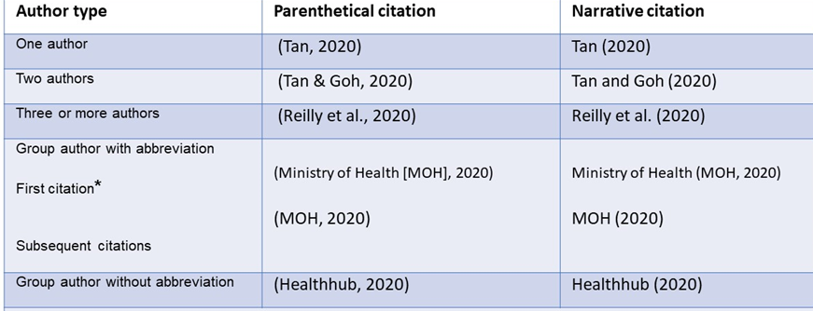
Citation and Referencing

Slide 19
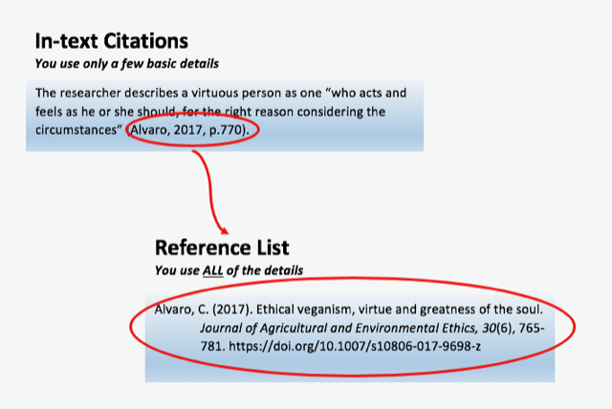
Citing and Referencing a Quote

Slide 20
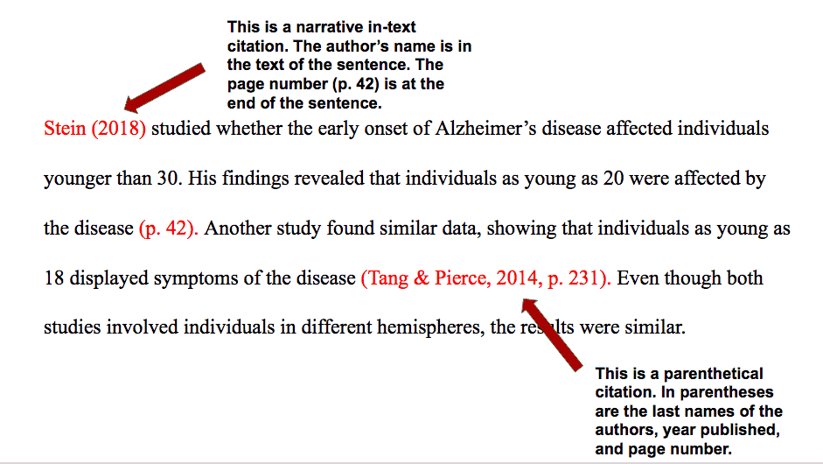

Slide 21
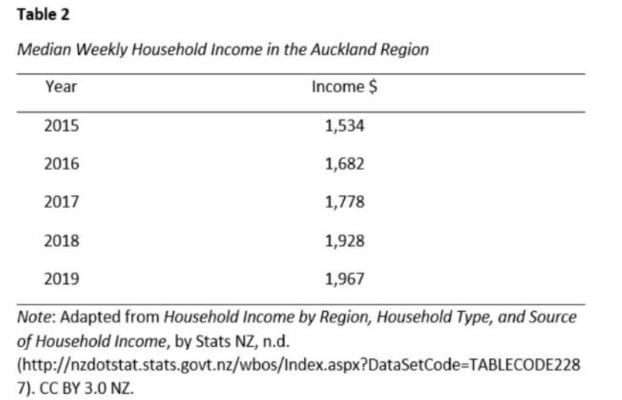
Representing Tables

Slide 22
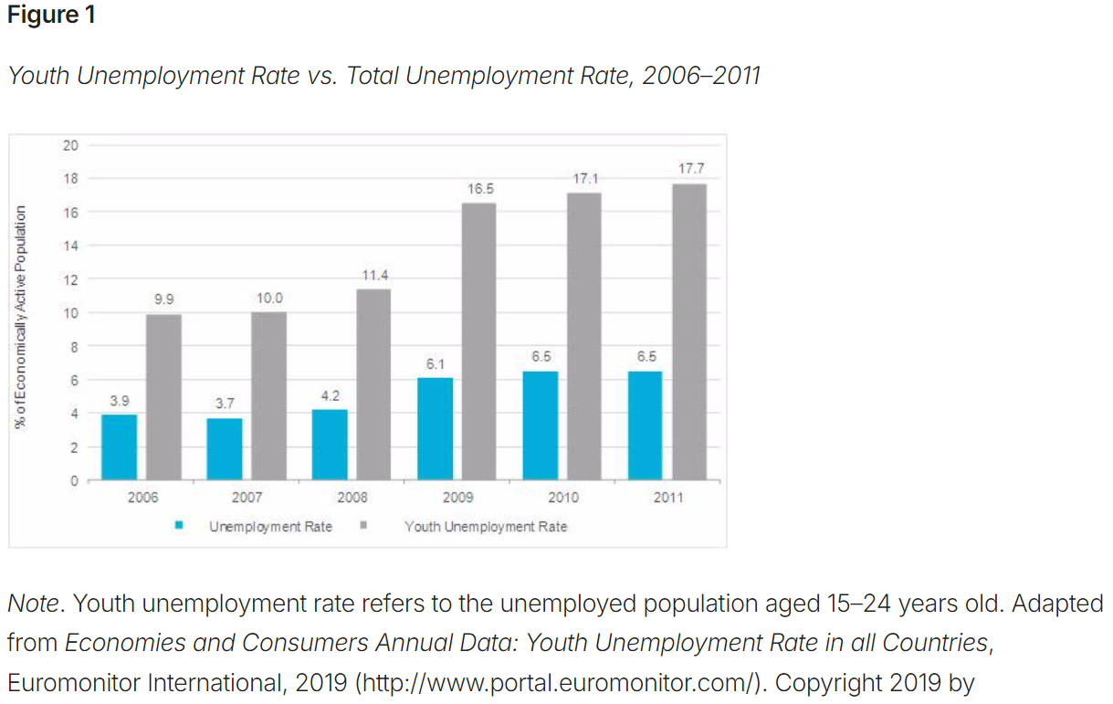
Representing Figures

Slide 23
Take away
Check on the following during your free time, how we reference:
Books
Journal articles
Conference presentations
Internet sources.

Slide 24
END

