Slide 1
Unit Two Introduction to Climate Change education, mitigation and adaptation
Facilitator(s):

Slide 2
Reflection
Share any changes or phenomenon that you have observed in your locality which you can attribute to climate change?

Slide 3
Expected Outcomes
Explain the meaning of climate change, climate change education, mitigation and adaptation.
Describe the causes and impacts of climate change to education/schooling and to communities
Appreciate the need for climate change knowledge and education.

Slide 4
Session Plan
 | Section of the Session | Time Minutes
1 | Introduction, Rationale and Objectives | 10
2 | Concept of Climate Change and Activities | 20
3 | Effects of Climate Change | 20
4 | Climate Change Educ. strategies and activities | 15
5 | Climate Change Mitigation and adaptation | 20
6 | Climate Change and STEM Education | 20
7 | Conclusion and Wrap up | 15

Slide 5
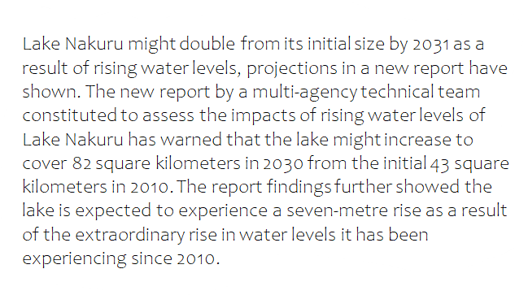
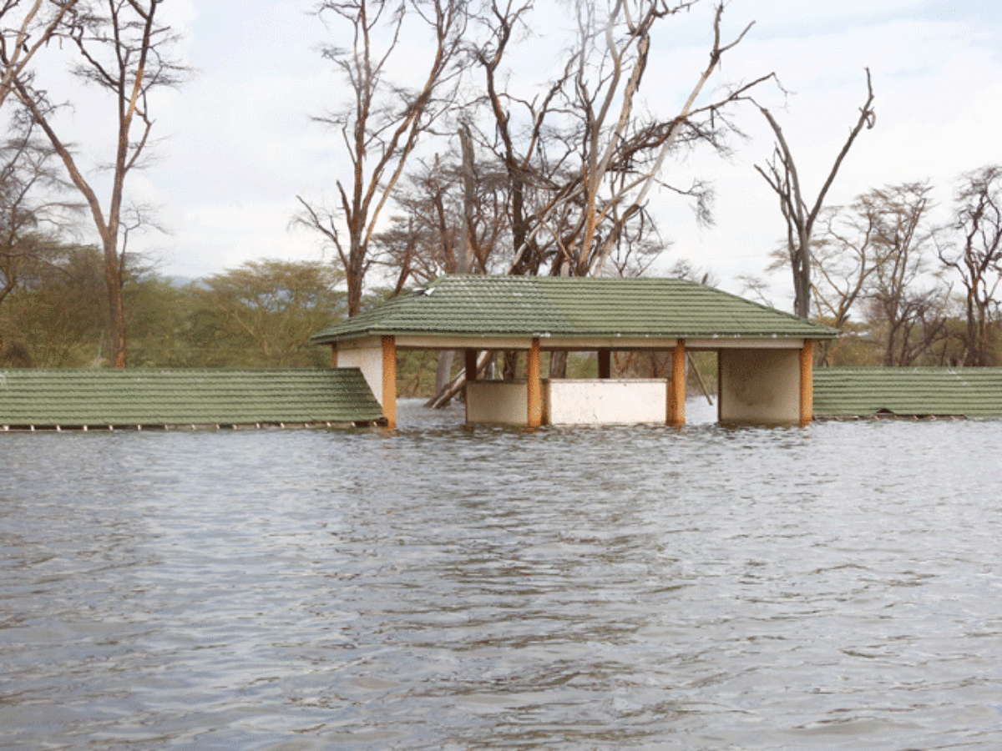
Activity One: Reflection; use reading and observation strategy:
Participants read the excerpt below and look at the picture about changes in Lake Nakuru. What comes to you mind? Have ever had such an experience in your area?

Slide 7
What is climate Change?
Activity Two: Use the meet your match strategy (10 minutes)
Participants are given A4 papers of different coloures and coloured crayons. They draw their ideas on what they see/know/hear/understand about climate change. Participants join those having the same colour of paper and share. Then groups share to plenary) what is climate Change?

Slide 8
Climate change
Climate change refers to shifts (change in the average conditions) in the earth’s temperatures and weather patterns, at local, regional, or global scales(over a long period of time).
Human-caused climate changes due to the burning of fossil fuels (coal, oil and gas) that release greenhouse gases and, the cutting down of forests have become more prevalent.
Climate changes incidences such as droughts, wildfires, and extreme rainfall are happening faster than previously predicted.

Slide 9
Effects of Climate Change
Activity Three: Use one-minute paper
(each participant to write down their response on sticky note and give the neighbour to read to the plenary)
What have you observed in your local area that you can attribute to climate change?
How is schooling affected by climate change?
How can schools interest learners in advocating for better understanding and increased response to climate change, at school and in their communities?

Slide 10
Effects of climate change to schools/schooling
Climate change effects such flooding destroys schools infrastructure (classes, toilets) and learning materials,
Threat of water borne diseases in cases of prolonged flooding
Prolonged flooding, drought and use of schools as emergency shelters prevents the continuation of education

Slide 11
Climate Change Education and Mitigation Strategies schools can use to integrate climate change education
Conversations
Go outside!
Focus on solutions
Empower action

Slide 12
Climate mitigation and adaptation ?
Activity Four: Group Discussion: Participants in groups and to explain while justifying the choices; what do you understand by Climate mitigation and adaptation
Climate change adaptation: Climate change mitigation refers to actions taken by governments, businesses, or people to reduce or prevent the effects of climate change. These include reduction of greenhouse gas emissions, or enhancing carbon sinks that remove these gases from the atmosphere.
Climate change mitigation: Climate change adaptation refers to actions that reduce vulnerability to the current or expected impacts of climate change such as weather extremes and hazards, sea-level rise, biodiversity loss, or food and water insecurity.

Slide 13
Projects on Climate Change in school
Biodiversity conservation in school
Energy management
Waste management in school
Flood management

Slide 14
Linking Climate Change and STEM Education
Climate change projects that relate to learners experience in STEM learning and help them use/ acquire mathematical and science process skills
Science | Technology | Engineering | Mathematical | Skills/Competencies
Observation Experimentation Properties of materials Questioning Hypothesizing Data collection Testing of materials Animal characteristics Classification | Technological tools Design Development Utilisation evaluation | Design process Planning Criteria/constraints Improving or redesigning Testing materials Designing/building Testing designs evaluating | Measurement Geometry Problem solving Estimation Time Budget/cost Figures Comparing Addition Fractions Probability | Team work Engaging/fun Hands-on Creative Communication Tie to prior experience Decision making Reflection Real life connection Open ended

