Slide 1
Training on Coding for Middle School Teachers
Facilitator: CEMASTEA

Slide 2
Session Three
An overview of Scratch

Slide 3
Reflection
What is Scratch programming?

Slide 4
Learning Outcomes
By the end of the session, the participants will be expected;
To navigate the Scratch interface and describe the functionalities of the icons in each area.
Describe the commands represented by various code blocks.

Slide 5
Scratch Programming
Scratch is a visual programming language that allows learners to create their own interactive stories, games and animations.
{watch a short animated clip made using
scratch}

Slide 6
View the clip

Slide 7
Activity 1
Describe the meaning of following terms as used in programming?
i) Animation
ii) Gaming

Slide 8
Definition of terms
Animation - display of a sequence of images of a character which create an illusion of movement
Gaming - the art of creating a game in Scratch

Slide 9
Other common terms as used in Scratch
a) Interface - Scratch software
b) Programming - the process of creating sets of instructions or commands that tell a computer what to do.
c) Coding - refers to the process of writing instructions or commands in logical and sequential steps known as codes that a computer can understand and execute.

Slide 10
Common terms as used in Scratch
d) Code blocks - puzzle-piece-like shapes which represent a set of commands that instruct the computer the task to be performed by the character in the story.
e) Sprite - the main character(s) in the story created. They can be made to move around, change appearance or even react when they touch something.

Slide 11
Common terms as used in Scratch
f) Backdrops - background displaying the scene of the character(s) in the story.
h) Project - story/game created in Scratch

Slide 12
Getting started with Scratch
Double click on the Scratch icon to get started..
This brings you to the interface home page which has 4 main elements namely;
1. Block Palette - also known as the programming palette
2. Code area - also known as the script area
3. Stage area
4. Sprite area

Slide 13
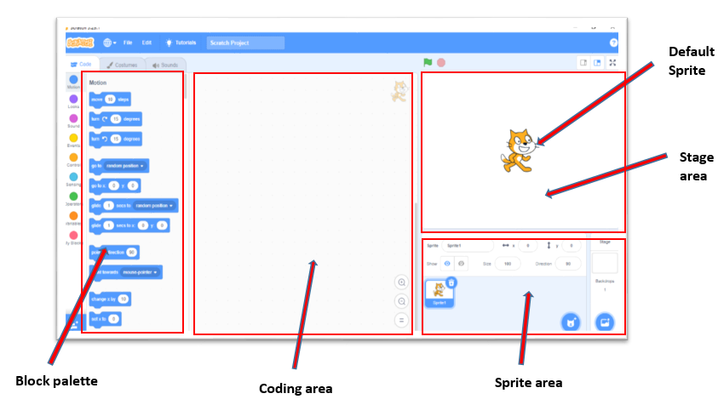
Scratch interface Home page
Notes:
Ask the participants to open Scratch on their devices

Slide 14
Description of Homepage
Block palette: This contains instruction blocks (code blocks) used to program the sprite to do or say something.
Coding area: This is the space where the code blocks are dragged and dropped as you write a program(story/games).

Slide 15
Description of Homepage
Sprite area: This is the area or space where the selected sprites appear and can be interchangeably controlled for display in the coding area. It defines the boundaries within which the sprite can move and interact with other objects. It is represented by a rectangular shape that encloses the sprite's image or costume
Stage area: This is the primary area where the action of the program is displayed as performed by the sprite. The stage may be of different backgrounds.

Slide 16
The Code Blocks
Are puzzle-piece-like shapes which represent a set of commands that instruct the computer the task to be performed by the sprite in the story
Code blocks are placed in different categories of commands.
The categories include motion, looks, sound, events, and control among others

Slide 17
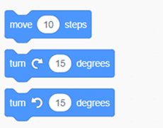
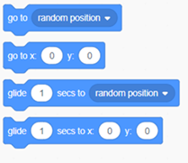
Motion Blocks
These blocks in Scratch are used to move or turn sprites around the stage. For example:

Slide 18
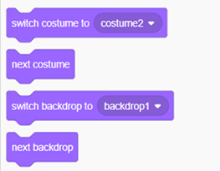
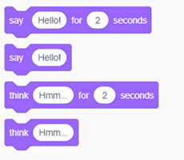
Looks Blocks
These code blocks are used for the purpose of controlling a sprite’s appearance (size, costume or visibility).
They are also used to add speech bubbles and change the backdrop.

Slide 19
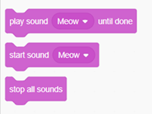
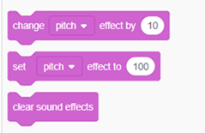
Sound Blocks
These code blocks are useful in adding music and sound effects. For example,

Slide 20
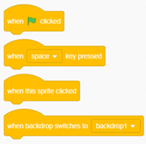
Events Blocks
These are the most important code blocks in Scratch. These blocks are used to start the code. They always come at the beginning of the code.
For example, when the green flag is clicked block.

Slide 21
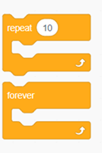
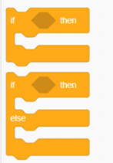
Control Blocks
Control blocks are used in Scratch to give certain conditions. Some of the commonly used control blocks are as shown below.
Repeat Blocks and If then else Block :

Slide 22
Activity 2
•Open the Scratch application
•Identify the motion, looks, sound, events and control blocks
•Drag the “When clicked” block from the block palette to the coding area.
•Drag the “Move block” to the code area and stack it under the “when clicked” block
•Click green flag once, then several times and make observation on the sprite..
Notes:
The facilitator can ask the participants to add more blocks with different commands and observe the sprite. As part of the extended learning

Slide 23
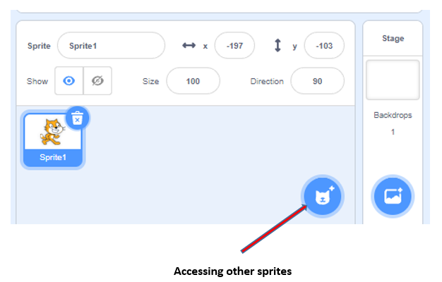
Accessing other sprites from the interface

Slide 24
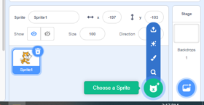
Click on choose a sprite icon

Slide 25
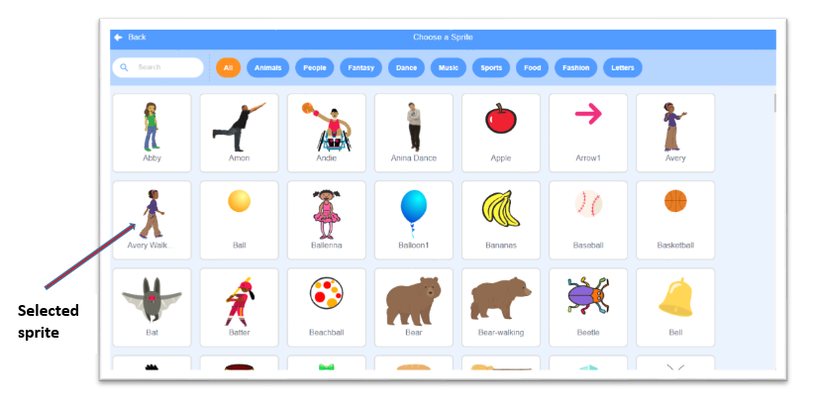
Select the sprite Avery walking

Slide 26
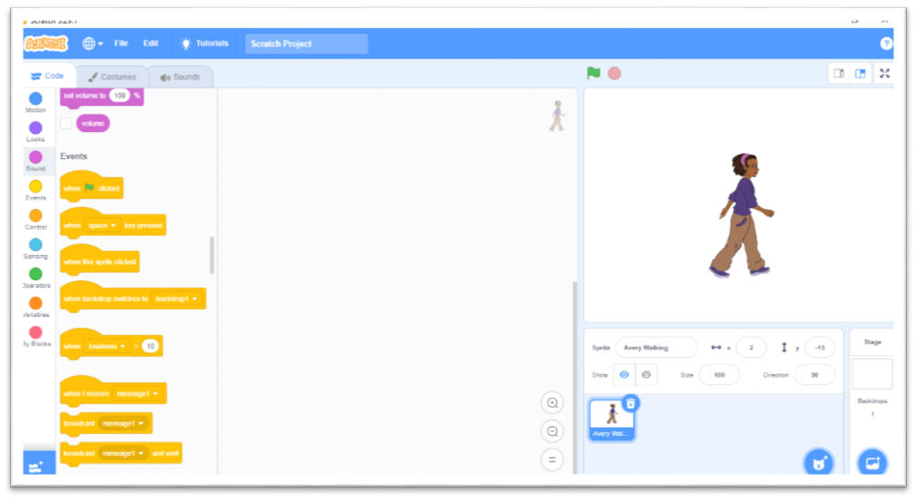
The new sprite

Slide 27
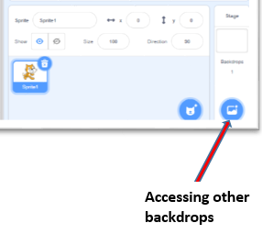
Changing the backdrop

Slide 28
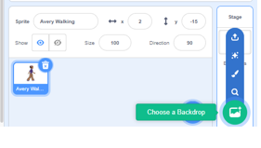
Click on choose a Backdrop icon

Slide 29
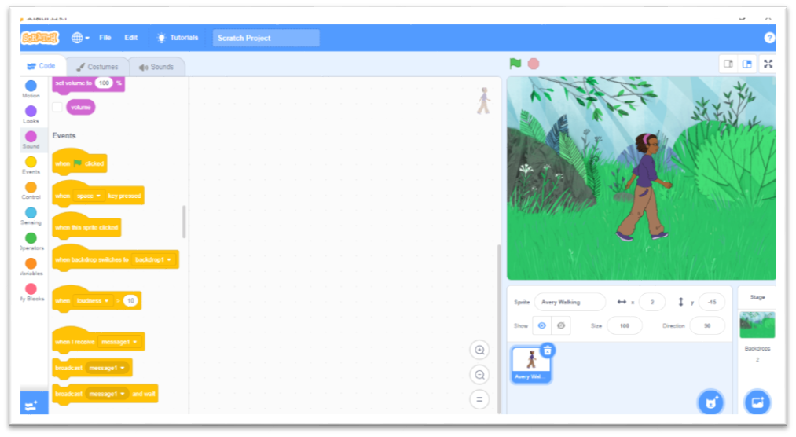
The new Backdrop
Notes:
Add the backdrops

Slide 30
Activity 3
a) Using the ‘choose a sprite’ icon, select a different sprite of your choice for your story.
b) Select an appropriate backdrop for your sprite in (a) above using the ‘choose a Backdrop’ icon.

Slide 31
Conclusion
In this session, you have learnt how to:
Access the Scratch interface
Change the character of the story
change the background
In the next session, you will have an opportunity to animate the sprites and create games

