Slide 1
Training on Coding for Middle School Teachers
Facilitator: CEMASTEA

Slide 2
Session Four
Animation Using Coding

Slide 3
Learning Outcomes
By the end of the session, you should be able to:
Describe animation in scratch programming.
Create animation using scratch programming
Appreciate the role of animation in scratch programing in nurturing core competencies

Slide 4
Reflection
1. What is animation?
2. What are some of the areas where animation are applicable

Slide 5
Definition of animation
Definition
process of manipulating still figures (sprites in scratch) to create the illusion of movement.
sprites (icons) are manipulated to create a combination of live action.

Slide 6
Applications of animation
Animations have application in the following:
education, entertainment and gaming, advertisement and marketing, architecture and engineering.
In the Competence Based Curriculum (CBC), animation can be used to facilitate
development of Core Competencies
learners’ understanding of PCIs
Formative assessment through project work

Slide 7
How to animate
Step 1: Storyboarding: imagining and creating a series of actions to be illustrated by the sprite
Step 2: Programming the sprites to illustrate the actions

Slide 8
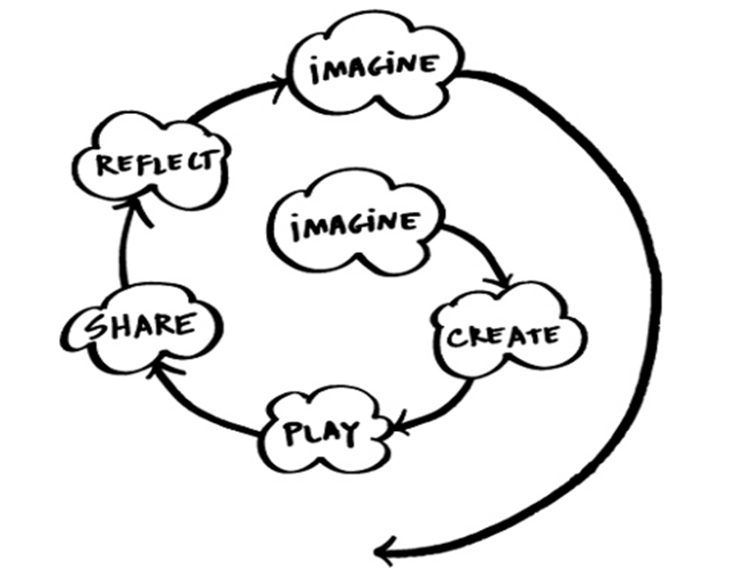
The spiral of creative learning "The kindergarten approach to learning" (Resnick, 2007).

Slide 9
Sample Animation activity
Imagine the animation:
Imagine the actions you want your sprite to perform
Create the animation:
How do you then sequence the imagined actions to be illustrated by the sprites?
Play the animation:
Explore and assess the programmed imagined actions through illustrations by the sprite?

Slide 10
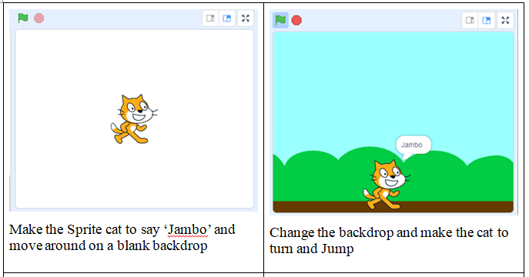
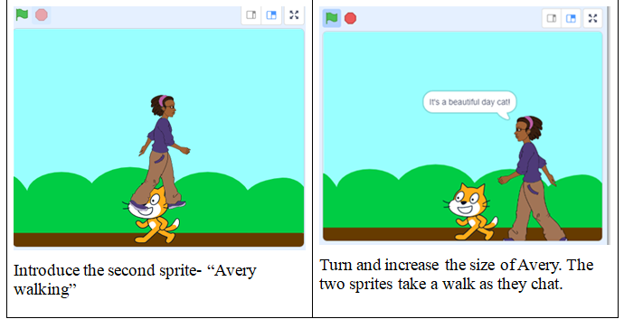
Imagine: What actions do you want your sprite to illustrate?

Slide 11
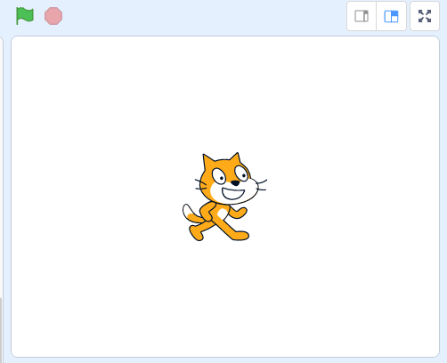
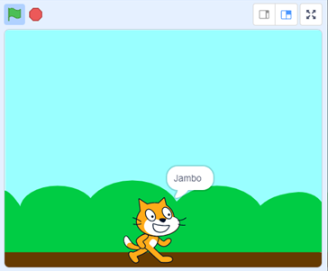
Create: Animate the sprites based on imagined ideas
let us practice the following imagined idea
Idea 1: Make the Sprite cat move around on a blank backdrop
Idea 2: Change the backdrop and make the cat jump and say Jambo

Slide 12
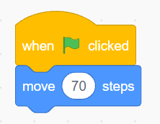
Step 1:Make the Sprite cat to say ‘Jambo’ and move around on a blank backdrop
Click on the Event category
Drag and drop the following code block into the Script Area
Click on the Motion category
Attach the ‘move’ code block to the previous ‘when-clicked’ the command block as shown below.
click on the Looks category
Drag and drop on the Script Area the command that says Hello for two seconds. Replace the word ‘Hello!’ with ‘Jambo!’

Slide 13
Click on the Events category
Drag and drop the ‘wait’ code block and attach to existing code block
Click on the motion category
Drag and drop three more ‘move’ code blocks and adjust the number of steps to 20, 40, and 50 as shown in the code block below.
Drag and drop the ‘go-to’ code block on the script area

Slide 14
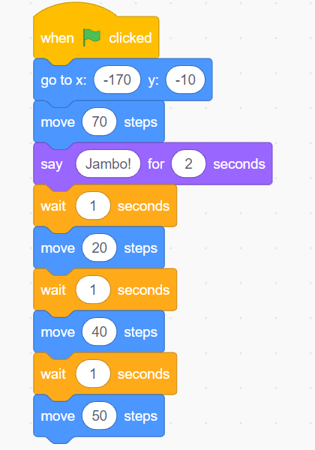
Final Code
Click the Green Flag on the top left-hand side of the screen and observe what happens to the cat sprite.

Slide 15
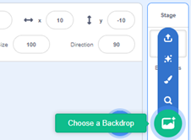
Step 2: Change the backdrop and make the cat to turn and Jump
Go to stage at the bottom left and click on the new Backdrops icon located under the Stage icon. Click on the Blue Sky backdrop
Drag and drop the ‘go-to’ code block on the script area to place the cat on the ground
Click on the costume tab
Click on the Flip Horizontal tab
The cat will turn to face the opposite direction as shown below.
Click on the code tab to go back to the coding area

Slide 16
Drag and drop the ‘glide’ code block on the script area
Move ‘the cat’ sprite at the bottom of the stage area. The X and Y coordinate will change accordingly as observed in the motion area.
To make the cat jump up for a specific number of times, click on the Control category
Drag and drop the ‘repeat’ code block to the existing code blocks such that the ‘glide’ code blocks are enclosed as shown.
To save the file, click on the file menu then click on Save to your computer

Slide 17
Play with the creations
Lets Explore and test boundaries of our animation. We will be clicking the Green Flag on the top left-hand side of the screen and observe what happens to the animation we have created.

Slide 18
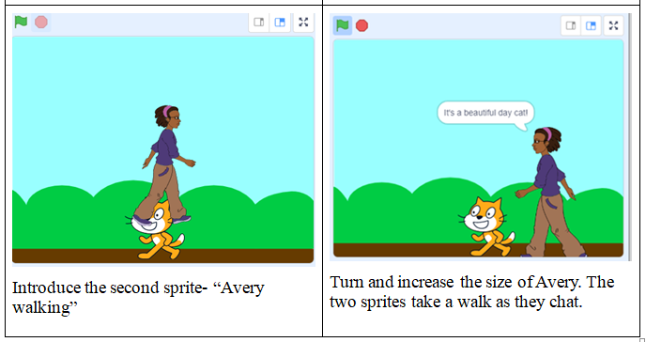
Session challenge (Assignment)
Imagine, create, and play

Slide 19
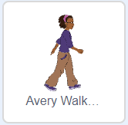
Step 3: Introduce the second sprite - “Avery walking”
Click on the file menu to open the project we were working on in the previous section myfirstproject. Click on Load from your computer
To introduce a new sprite, click on the Choose a Sprite icon
Click on the ‘Avery Walking’ Sprite
Click on Events category and drag and drop the ‘when- clicked’ block code in the Script area
On the Looks category, add the ‘show’ and ‘hide’ code blocks.
Add a ‘wait’ code block to input the number of seconds ‘Avery Walking’ will wait before appearing.

Slide 20
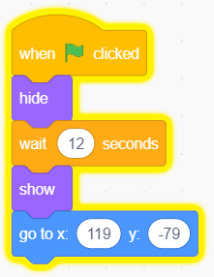
The code will look something like this:
To code Avery Walking to say “it’s a beautiful day cat!’ Click in the input box and change from ‘Hello!’ To ‘It's a beautiful day cat!’
Add a code where ‘the cat’ will respond with a ‘purr!’

Slide 21
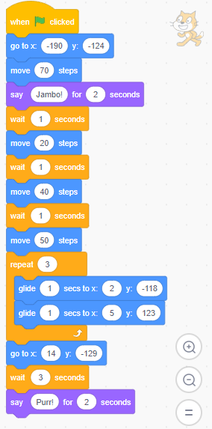
Final Code

Slide 22
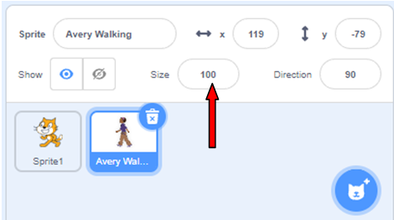
Step 4: Turn and increase the size of ‘Avery Walking’. Make ‘Avery Walking’ with ‘the cat’ take a walk as they chat.
On the Sprite List section, click on the ‘Avery Walking’ icon to activate it
Click on the Size input box. Change from 100 to 120
Activity
Build up ‘Avery Walking’ and ‘the cat’ code blocks to make them walk as they talk.
Final code for Sprite 1: CAT and ‘AVERY WALKING’

Slide 23
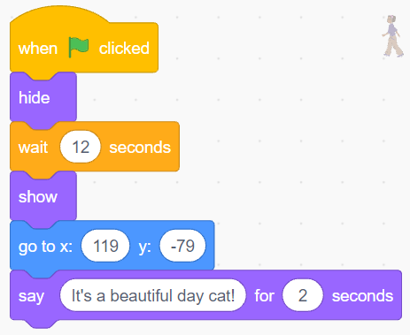
Final code for Sprite 1: Cat and ‘Avery Walking’

Slide 24
Play (Session challenge)
It involves a process of trial and error.
Explore and test boundaries of animation by;
Change the sprites and backdrop
Make the sprite glide in different directions
Add a third sprite and animate it as you like
Continue the conversation between Avery and the cat.
Trying out different codes blocks

Slide 25
Share the ideas and creations with others
We will share our ideas on;
The changes we have made to the sprites and backdrop
The reason making the changes
Additional code blocks that you might have used.
Reflect on the experiences of animating.
Imagine new animation ideas and project to do
We will come up with new animation ideas by drafting a storyboard

