Slide 1
UNIT 3: MENTORSHIP AND CAREER GUIDANCE IN JUNIOR SCHOOL
Facilitator

Slide 2
Introduction
In this unit, you will:
share experiences and enhance your knowledge and skills in providing mentorship and career guidance to learners.
focus on how to encourage learners to pursue STEM pathway and related careers.
Discuss role of teachers, parents and resource persons in mentorship and career guidance of JS learners is included.

Slide 3
Session Plan
Section | Time allocation
Introduction, rationale and session outcomes | 10 minutes
Activity 1: Reflection on mentorship | 10 minutes
Activity 2 Career Guidance (Think, Pair and share) and summary Elements of career guidance Tips for effective career guidance | 15 minutes
Link between JS and SS in CBC and STEM Pathway | 10 minutes
Activity 3 ( Strategies to enhance mentorship and career dvpt) | 40 minutes
Activity 4: Extended activity | 15 minutes
Conclusion | 5 minutes

Slide 4
Rationale
JS offers a broad curriculum to prepare learners for pathways in Senior School.
Learners need to be exposed to a variety of experiences and career options through mentorship and career guidance.
60% of JS learners are anticipated to embark on STEM pathway.
Teachers handling STEM-related subjects play pivotal roles as mentors and guides, ensuring inclusivity and offering inspirational support to help learners realize their full potential.
This session enhances your understanding of mentorship & career guidance and how to support learners in career choice.

Slide 5
Session outcomes
Describe effective strategies for guiding and mentoring learners to pursue STEM pathways.
Discuss the importance of career guidance and mentorship for JS learners
Develop a career guidance and mentorship program for their schools
Enjoy sharing ideas on career guidance and mentorship for JS learners.

Slide 6
Activity 1; Reflection
“Ever since I was a child, I tried to imagine what I would do for work as an adult. I had so many ideas. One day I would want to be an Engineer in the Agricultural sector, the next a lawyer and so on and so forth. It was all so confusing! Eventually I gave up trying to figure it out.”
Discuss how would you help the learner?

Slide 7
What is Mentorship?
Learners have competing aspirations on careers they would wish to pursue in the future
A teacher knowledgeable in mentorship can help learners make informed decisions on what careers to pursue.
Mentorship is a relationship between an expert (Mentor) and a novice (Mentee).

Slide 8
Cont……
The expert supports the novice in decision making within the profession by sharing knowledge and skills
In JS, the teacher is the mentor and the learner is the mentee.
The JS teacher is expected to mentor the learner on subjects that lead to STEM pathway in SS.

Slide 9
What are the competencies of
a teacher as a Mentor?
Coaching; a mentor should be able to motivate high performance
Counseling; a mentor should be able to listen to the mentee and advise
Role model; a mentor should be able to lead by example
A champion; a mentor should guide and support the mentee in career development
Teacher as a mentor should be able to share knowledge and skills with mentees

Slide 10
What roles can a JS teacher play in Mentorship?
Sharing information about his or her own career path
Providing guidance on study habits and setting goals
Motivation
Emotional support
Role modeling and networking
Assist students with special needs and disabilities in recognizing suitable career prospects

Slide 11
Career Guidance
Activity 2: Think, pair and share
a)What is your understanding of career guidance?
b)Discuss the importance of career guidance to the learners.
c)What careers are associated with the following subjects:
Pre-technical Studies
Agriculture and Nutrition?

Slide 12
Career Guidance
Involves providing information and engaging learners in activities:
to help them to make educational, training and occupational choices and to manage their careers.
about the labor market, educational and employment opportunities and makes it accessible by organizing it, systematizing it and having it available when and where people need it.

Slide 13
Cont…..
to assist learners to reflect on their aspirations, interests, competencies, personal attributes, qualifications and abilities and to match these with available training and employment opportunities.
to assist them in matching their abilities and aspirations to careers.

Slide 14
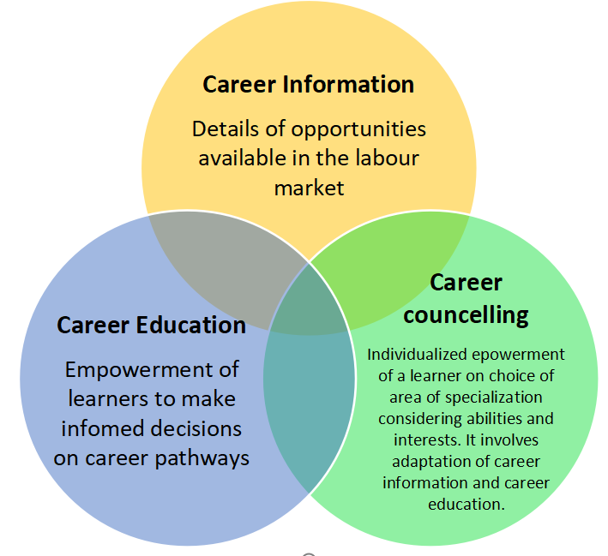
Elements of Career Guidance

Slide 15
Importance of Career Guidance
1)Lifelong learning goals: Combating early school drop-out and ensuring an adequate knowledge and skills base in the context of economic globalization and promoting adequate linkages between education, training and the world of work.
2)Labour market outcomes: Reducing mismatches between supply and demand for labour, dealing with unemployment and improving labour mobility.
3)Social equity and social inclusion goals: Promoting reintegration of marginalized groups and persons with disabilities into education, training and employment sector.

Slide 16
Activity 3: How can you establish an effective career guidance in your school?

Slide 17
Tips for Effective Career Guidance in Junior School
Establish a Career Guidance Committee to implement and coordinate the career guidance programmes
Ensure scheduling of career guidance in the school timetable
Embrace an inclusive approach by offering needs-based career guidance to all learners

Slide 18
Tips for Effective Career Guidance in Junior School
Sensitize all learners on career choices based on the CBC pathways.
involvement of parents/guardians and experts
Expose learners in activities such as job shadowing and other experiences to nurture them into future career opportunities.

Slide 19
Link between Junior School and Senior School in CBC
The Essence of JS
Broad based curriculum is offered to enable the learner to explore their own interests
Discover their own potential
Career guidance is one of the learner support programmes

Slide 20
Link between Junior School and Senior School in CBC

Slide 21
Link between Junior School and Senior School in CBC
BECF proposes that 60% of learners in SS to pursue STEM related subjects:
8%- Pure Sciences core subjects are; Community service learning, P.E., ICT optional are: Mathematics, Physics, Chemistry and Biology)
12%- Applied Sciences( Agriculture, computer science, food and nutrition and Home management) Optional are; Optional , Agriculture ,Computer Science , Foods and Nutrition ,Home Management

Slide 22
Cont…..
15%- Technical and Engineering (Community service learning,P.E., ICT, Maths, Physics/Physical ,sciences, Chemistry/ Biology/Biological Sciences)
25% Career and Technology Studies(Community service learning, P.E. and ICT)

Slide 23
Activity 4
1)Identify strategies and activities that can be implemented in your school by the following to enhance mentorship and career guidance of learners:
Teachers
School leadership
Parents
Resource persons.
2)What strategies and activities discussed under (1) can be implemented in your school to enhance learners interest in Pre-technical Studies and Agriculture and Nutrition subjects?
Notes:
NB: slides 20 to 27 are responses to activity 4 and hence the facilitator uses only what has not been mentioned by participants BUT not reading word for word

Slide 24
Strategies and Activities:
Establish a Career Guidance Committee to implement and coordinate the career guidance programmes
Ensure inclusion of career guidance in the school timetable
Offer needs-based career guidance to all learners.
Sensitize all learners on career choices based on the CBC pathways.
Notes:
Establish a Career Guidance Committee to implement and coordinate the career guidance programmes
Establish a Career Guidance Committee to implement and coordinate the career guidance programmes

Slide 25
Strategies and Activities Cont’d
Collaborate with parents and guardians on how to guide learners to choose the career pathways based on their abilities and interests
Utilise the services of experts on career choice and modelling as per the list approved by Ministry of Education
Expose learners to job shadowing and other experiences to nurture them into future career opportunities.

Slide 26
Role of Teacher in Mentorship and Career Guidance of Learners
Providing mentorship and guidance to learners
Preparing a mentorship and career guidance programmes for learners
Identify students careers, aspirations and abilities by carrying out functional assessment for learners
Identification of potential careers and provide career information and requirements through brochures and prospectus

Slide 27
Providing mentorship and guidance to learners
Engaging resource persons in mentorship and career guidance
Integrating career education in the learning process
Providing career counseling
Identification of available careers with appropriate adaptations for learners with special needs and disabilities

Slide 28
Role of Teacher Cont’d
Involving parents in career guidance of learners
Invite parents for consultation meetings (academic clinics)
Create forums to educate parents on issues like change of attitude towards children's performance, interests, careers
Design programmes where parents discuss career opportunities for learners
Establish effective communication channels with parents

Slide 29
Role of Teacher...Cont’d
Involve parents in Community Service Learning activities and volunteer opportunities
Establishing effective communication channels with parents on a regular basis on schools’ programmes and learner’s improvement
parents of children with disabilities be empowered to engage in career guidance for their children.

Slide 30
Involving Resource persons
Identifying and inviting resource persons.
Organizing for talks and presentations by resource persons
Creating a positive and enabling environment for motivating the learners to freely discuss their learning areas and career preferences.
Providing basic resources towards the development of the learner’s career

Slide 31
Roles of Parents in Mentorship and Career Guidance of Learners... Cont’d
Providing information on career opportunities available to their children
Providing information on adapted career opportunities available for leaners with special needs and disabilities
Understanding the learner’s abilities and interests in order to provide the required guidance
Detecting any early learning and behavioral related manifestations in the child and make timely corrective interventions

Slide 32
Roles of Parents in Mentorship and Career Guidance of Learners... Cont’d
Helping in decision making regarding career choices in consideration of the learner’s interest and abilities
Providing motivation and encouraging the learner to work hard
Exposing the learner to opportunities to discover, practice and develop their areas of interest.
Parents should act as role models
Provide and ensure protection of the learner from danger, exploitation and other vulnerable situations as they explore their talents and abilities

Slide 33
Roles of Resource Persons
Giving talks to learners based on their professions.
Volunteering in facilitating learning of specific concepts under development and provide linkages to relevant career pathways
Assisting the teacher in providing explicit information to learners during Field trips

Slide 34
Roles of Resource Persons
Providing occupational and labor market information to the learners
Assisting the learner to carry out research on available career opportunities in the economy based on a learner’s interests, talents and abilities.
Offering themselves for job shadowing for learners

Slide 35
Activity 5
NB: Activity 4 is inteneded to actualize mentorship and career guidance in JS towards enhancing the preparation of learners to pursue STEM pathway in Senior School. To get you started refer to strategies and activities suggested in activity 3.
Using the template provided, draw a program of activities that can be implemented in your school to enhance mentorship and career guidance for learners in a term.

Slide 36
DATE | Strategy | ACTIVITY | Resources | RESPONSIBLE PERSONS | COMMENTS e.g timelines

Slide 37
Conclusion
Mentorship and career guidance in schools explores the ways in which support for learners can be used as a dynamic collaborative process for effective career choice.
Through mentorship and career guidance, teachers, parents and other resource persons are responsible in one way or the other in impacting the education, career pathway and lives of the learners.
Career guidance needs to move towards encouraging career management rather than providing one-off testing and advice to learners.

Slide 38
Cont……..
Teachers in junior secondary schools are expected to provide regular mentorship, career education, career information and career counseling to the learners to gives them a sense of direction on which career to choose hence enriching the world with good service and learners’ holistic development.
The teachers also need to embrace inclusivity by advocating for reasonable accommodation for learners with special needs and disabilities.

