Slide 1
Session Five
Games and Graphics Using Scratch

Slide 2
Introduction
Scratch games promotes learner’s computational thinking, creativity, and problem solving skills
Scratch enhances learner’s high order thinking skills as they come up with creative solutions to problems

Slide 3
Learning outcome
Create simple games and graphics for enjoyment

Slide 4
Creating
Activity
How can we create a maze game using scratch application?

Slide 5
How create the maze
A maze is a puzzle with twists and turns, where you try to find a path from the entrance to the exit
First we will sketch on a piece of paper a maze with a clear path from start to exit.

Slide 7
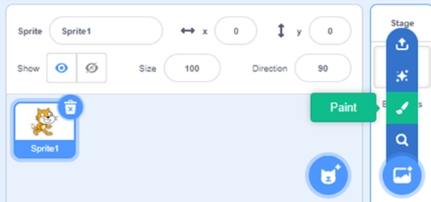
Let’s turn our sketch into a backdrop
Open the scratch application
On the bottom right corner click on the paintbrush on the pop up menu.

Slide 8
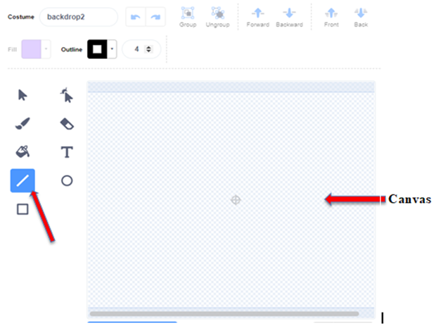
Select the line icon highlighted in blue

Slide 9
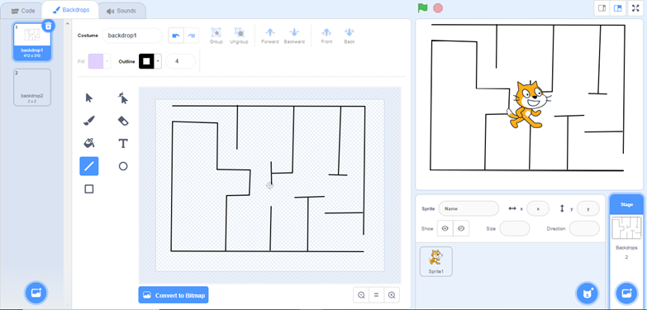
Draw your maze on the canvas with the help of your mouse pointer. As you draw, your maze will appear as a backdrop
Notes:
Demonstrate how it is done

Slide 10
How to create a maze game
We will code two sprites; a Sprite 1 the cat and a packet of milk.
The goal is to make the ‘cat’ sprite move along a path in the maze till it reaches the ‘milk’ sprite.

Slide 11
For this game we want the ‘Milk’to make a sound when ‘Sprite 1’ touches ‘milk’.
The code block to use will
include the Motion, Looks,
Sound, Control, Sensing and
Events.

Slide 12
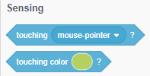
The sensing blocks will be used to tell or highlight how sprites interact with their surroundings.

Slide 13
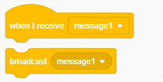
The broadcast block will broadcast messages to let one part of the code or project communicate with another part.

Slide 14
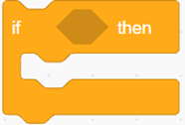
An if-then block code will be used to ensure that the sprite only uses the designated path to the milk.

Slide 15
A forever code block will be used to repeat the sequence of commands to ensure the continuity of the game.

Slide 16
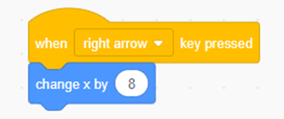
Coding Sprite 1: the cat
Click on ‘the cat’ Sprite
Change the sprites position using x and y coordinates for the sprite to move in the different directions
a. Right arrow

Slide 17
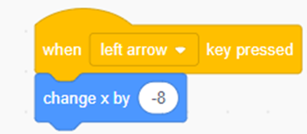
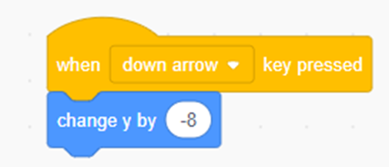
b. Left arrow
c. Down arrow

Slide 18
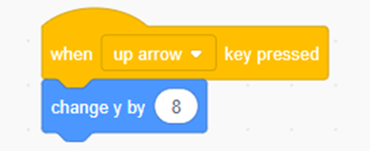
d. Up arrow
Notes:
At this point ask the Participants to test the code and see if it runs

Slide 19
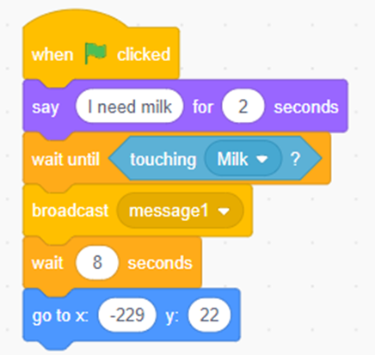
To the ‘Milk’ to make a sound when ‘Sprite 1’ touches ‘milk’ Create this code
Notes:
Take them Trough adding these codes

Slide 20
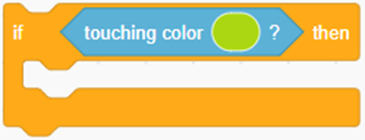
Adding a condition to return the sprite to the beginning if it touches the lines of the maze
Drag and drop a second ‘when- clicked’ block into the Script Area
Add the ‘if-then’ code block
Drag and drop the ‘touching color’ code block on the ‘if-then’
code block

Slide 21
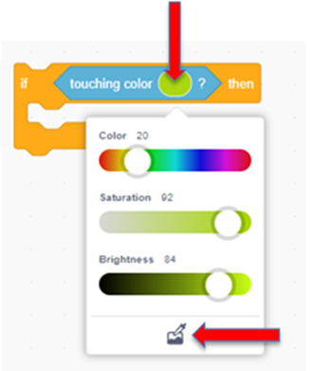
Click on the color, a drop-down menu will appear.
At the bottom of the color code, click on the paint icon

Slide 22
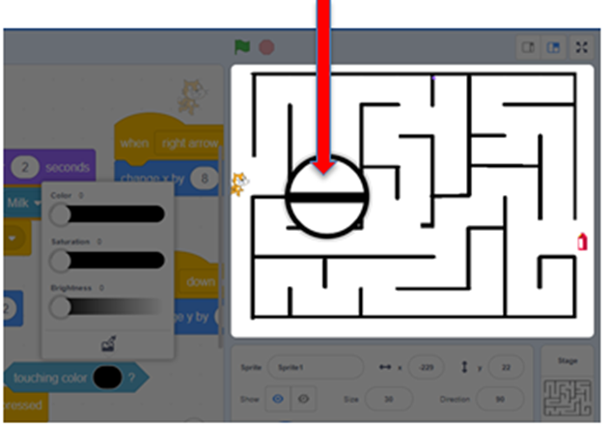
Move the mouse cursor on the maze. A magnifying glass will appear, click on any line of the maze. The color on the code will change to reflect the
color of
the maze.

Slide 23
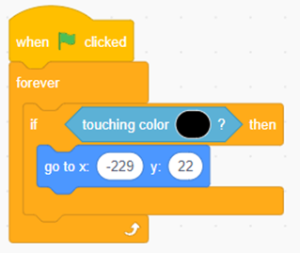
Drag and drop the ‘go to x: y’ code block inside the ‘if-then’ code block. This will take the cat back to the starting point when it touches the boundaries/line of the maze.
Drag and drop the ‘forever’
code block to
encapsulate the
‘if-then’ code block

Slide 24
Adding one more condition to control the use of a mouse pointer
Drag and drop a third ‘when- clicked’ block into the Script Area
Add the ‘if-then’ code block
Drag and drop the ‘touching mouse-pointer’ code block on the ‘if-then’ code block

Slide 25
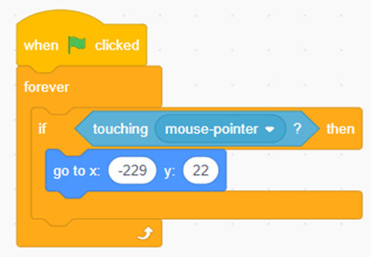
Drag and drop the ‘go to x: y’ code block inside the ‘if-then’ code block. This will restrict moving ‘the cat’ using a mouse pointer.
Insert the ‘forever’ code block inside the ‘if-then’ code block

Slide 26
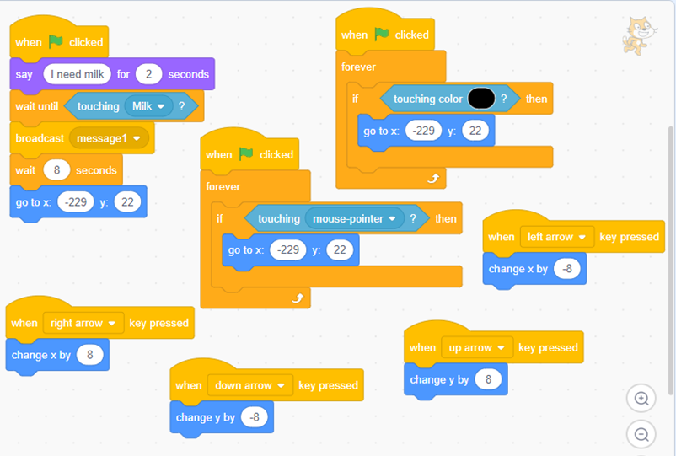
Final code should look something like this:

Slide 27
Coding ‘Milk’ sprite
Click on the ‘Milk’ sprite to highlight and code it.
Drag and drop a second ‘when I receive’ code block into the Script Area

Slide 28
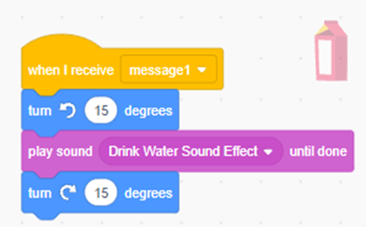
Attach an anticlockwise ‘turn degrees’ code block
Drag and drop the play sound-until done code block
Attach a clockwise ‘turn degrees’ code block

Slide 29
Now let us explore and test the boundaries of the game by playing the game.
(attach link)

Slide 30
Share
Share the ideas about the game with others on the following;
What was good about the game
The challenges faced when coding
Areas of improvement

Slide 31
Reflect
Reflect on the experiences of coding a game in scratch.

Slide 32
Project task
Imagine
New game ideas you can create. Draft the ideas in a storyboard then create a game on any of the Pertinent and Contemporary Issues (PCIs)

Slide 33
Suggestions:
Equality Puzzle: Design a puzzle game that promotes diversity and inclusion.
Food Waste Challenge: Create a game that educates players about the issue of food waste.

Slide 34
Cybersecurity Defender: Design a game where players take on the role of a cybersecurity expert defending a virtual network from cyber threats.
Climate Challenge: Create a game where players must navigate a world affected by climate change.

