Slide 1
Session Five Scratch Project
Facilitators

Slide 2
Scratch Project
We are going to use scratch to find a solution to a problem in our local environment
Session outcomes
Describe how to use scratch to find a solution to a problem in our local environment
Create solution using scratch programming in local environment
Appreciate the role of scratch programming in solving problems local environment

Slide 3
Scratch Project
Example
A primary school is located along a busy highway. Learners cross this road to access the school in the morning and in the evening while going home. The problem is how to guarantee the safety of learners while crossing the busy highway

Slide 4
Scratch Project cont….
Reflection
What safety rules/ steps will learners follow while crossing the road?

Slide 5
Solution
Safety rules/ steps that learners can follow while crossing the road:
Move to the road edge and stop
Check left, right and left again before crossing
Look around while crossing to spot any oncoming car or motorbike
If the road is clear, then cross.

Slide 6
Trial code to solve the problem using paper
Manila papers can be used to form blocks labeled with instructions to solve the problem
The instructions will need to be arranged in a logical manner as follows:

Slide 7
Solving the problem using scratch
The manila paper blocks with instructions to solve the problem can be used to form the code blocks on the scratch.
The codes can be picked from the code categories of motion, looks, sound, events and control button
The code blocks are dragged to the code area and arranged in a logical manner as follows:

Slide 8
Code blocks arrangement
Reflection
Using your knowledge in scratch, find the code blocks that match the paper codes below

Slide 9
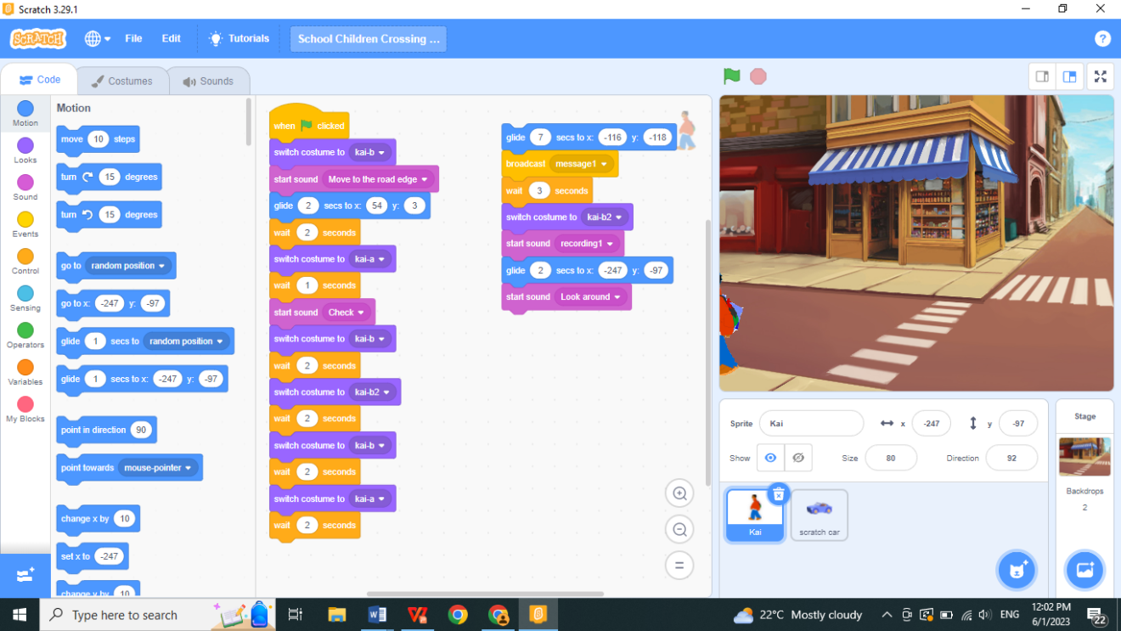
Expected Code blocks arrangement
Notes:
Facilitator will be expected to demonstrate how to arrange the code blocks during harmonization

Slide 10
Expected Code blocks arrangement
Link to children crossing the road video

Slide 11
Group activities
Activity 1
In groups discuss and name one problem found in your environment.
In your note books, write, draw blocks, and describe how you will solve the problem.
Using Manila paper and scissors cut out all the blocks needed to solve your problem.
Label them with the instructions you will use to solve your problem.
Arrange them in a logical manner.
Draw your arrangement in your notebook

Slide 12
Group activities contd…
Activity 2 : Solving your problem with scratch
Refer to the paper code blocks in activity 1 and draw the code blocks on scratch using the various code categories. Drag them to the code area.
b)Arrange your code blocks in a logical manner

Slide 13
Conclusion
In this training you focused on Scratch.
Scratch is a programming language to teach children the basics of programming through a visual interface.
Scratch allows users to create interactive stories, games, and animations by dragging and dropping blocks of code.
Learners are engaged in a fun and interactive way, while also learning important coding concepts.

Slide 14
Conclusion contd..
This promotes several CBC fundamental skills, such as problem-solving, communication, and cooperation
Scratch is a valuable tool for introducing learners to the world of coding.
You are encouraged to join https://scratch.mit.edu/ and be part of the online community on the scratch platform to showcase your learner’s projects as well as learn from others in the global community.

